Slide 1


Supporting Struggle & Discourse
with H.O.T. Tasks
Chris Shore, Murrieta Valley USD, CA
shore@mathprojects.com, @MathProjects
Austin, 2025

Slide 2
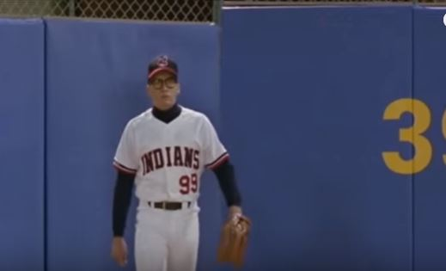
What is Your Walk-Up Song?

Slide 3
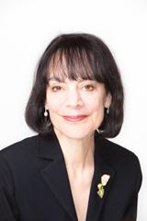

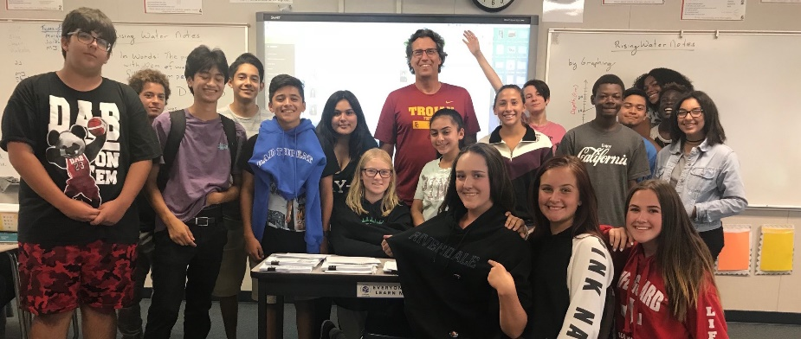
Mindset
of students
of teachers!
They are that smart
&
We are that good!

Slide 4
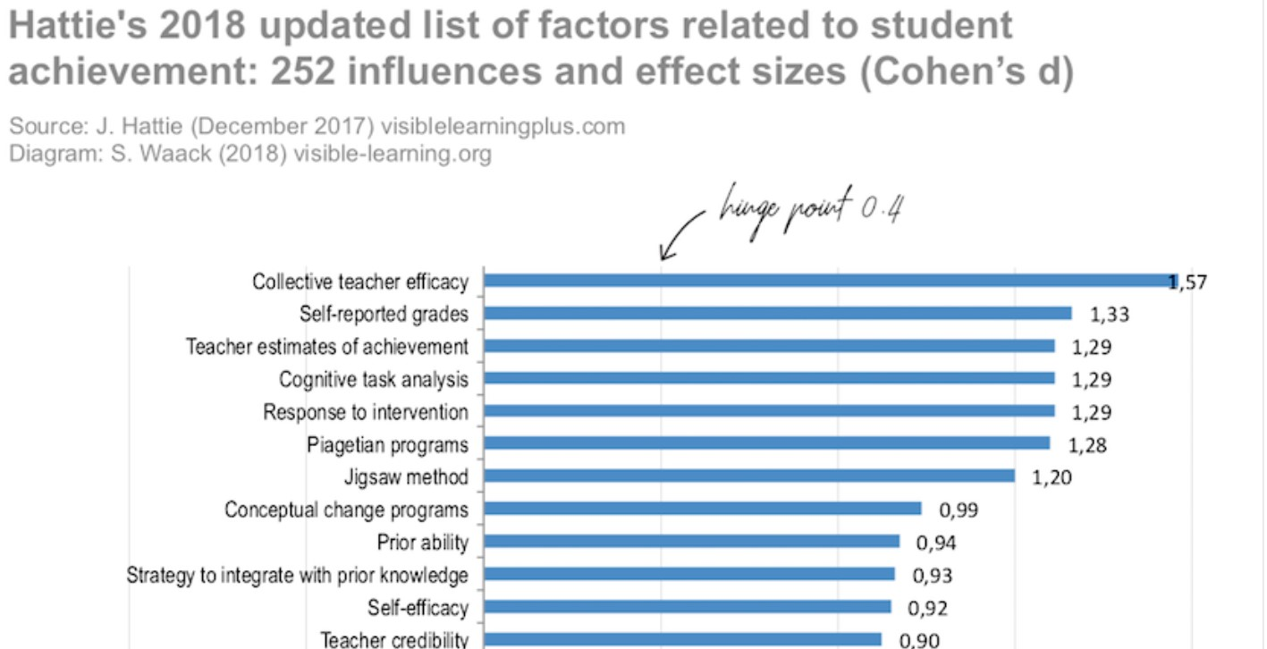
Mindset

Slide 5
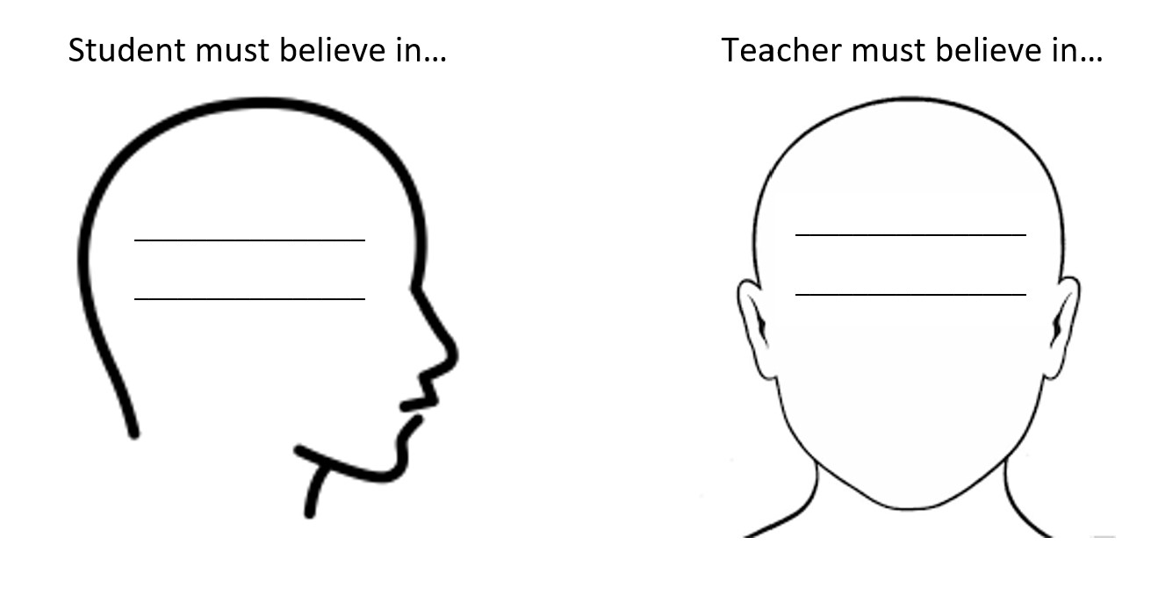

Mindset
Themselves
Themselves
Teacher
Students
Collective Teacher Efficacy

Slide 6
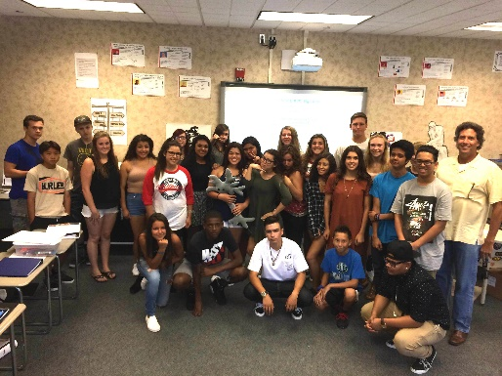

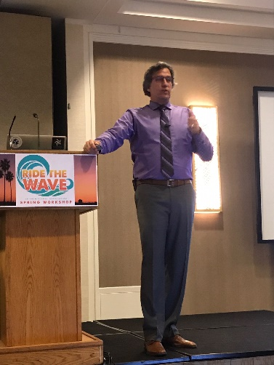

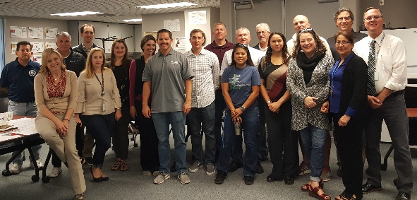
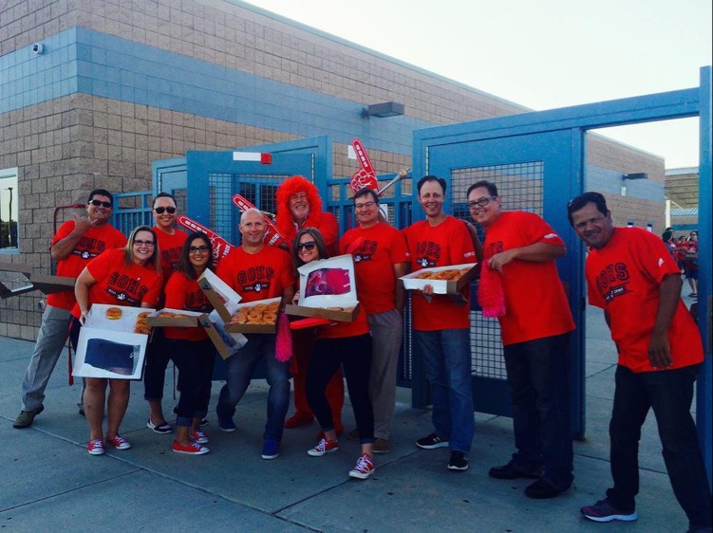


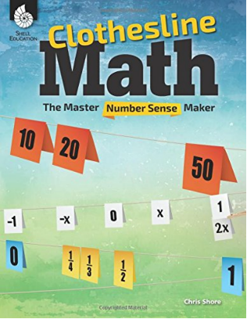



The World I Come From
Chris Shore

Slide 7


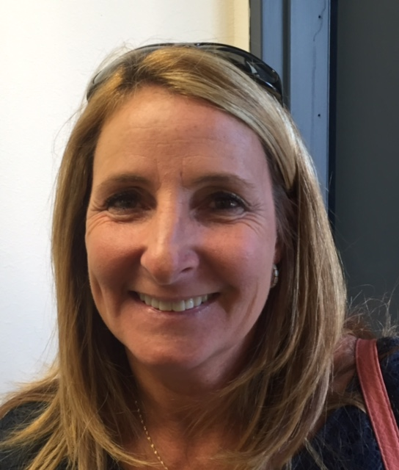


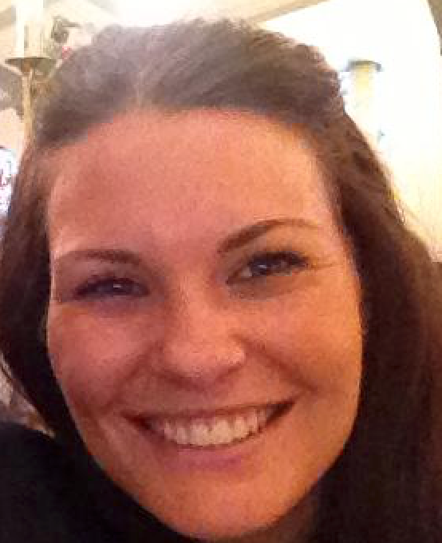





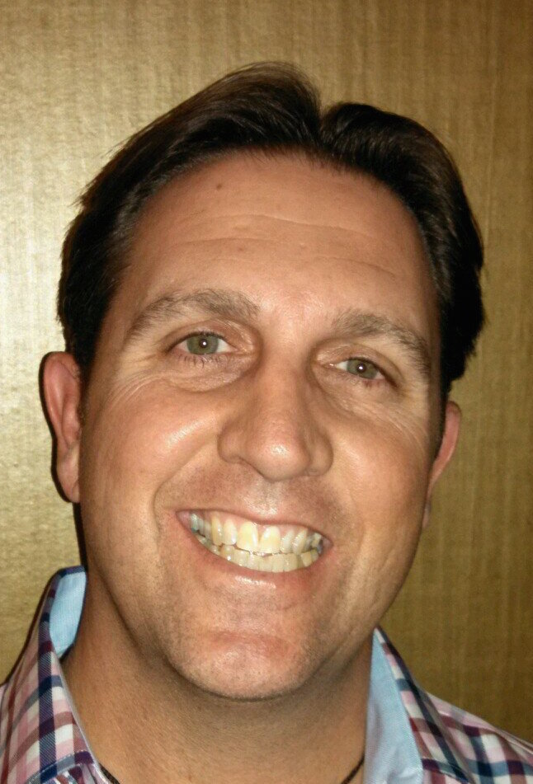
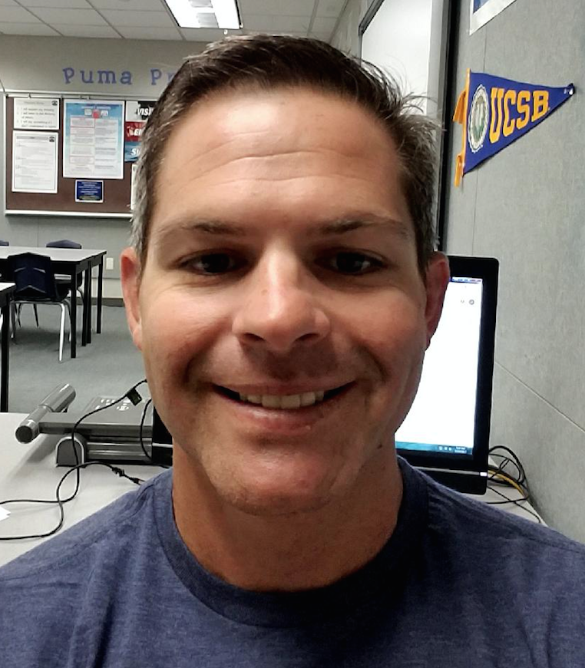

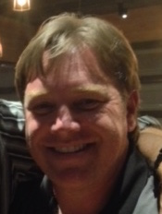



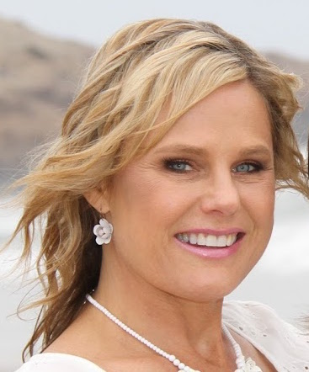

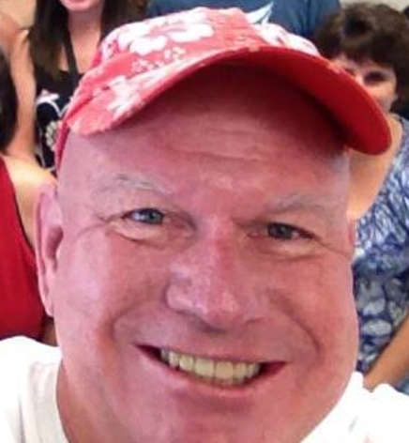

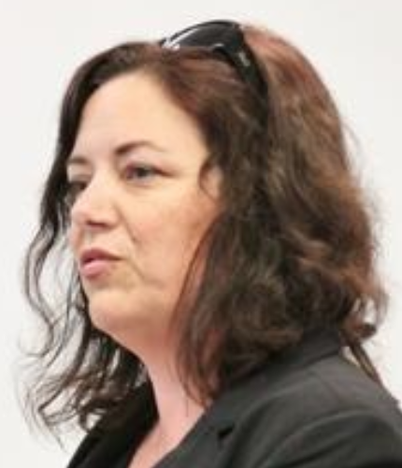


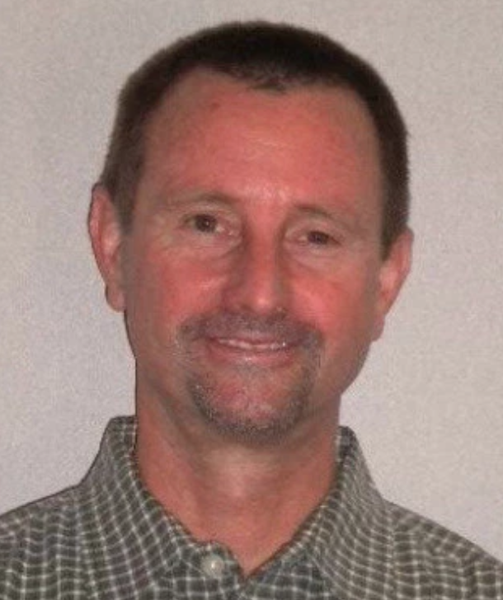

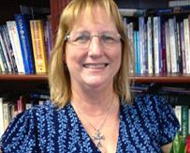
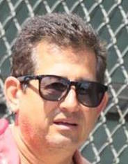



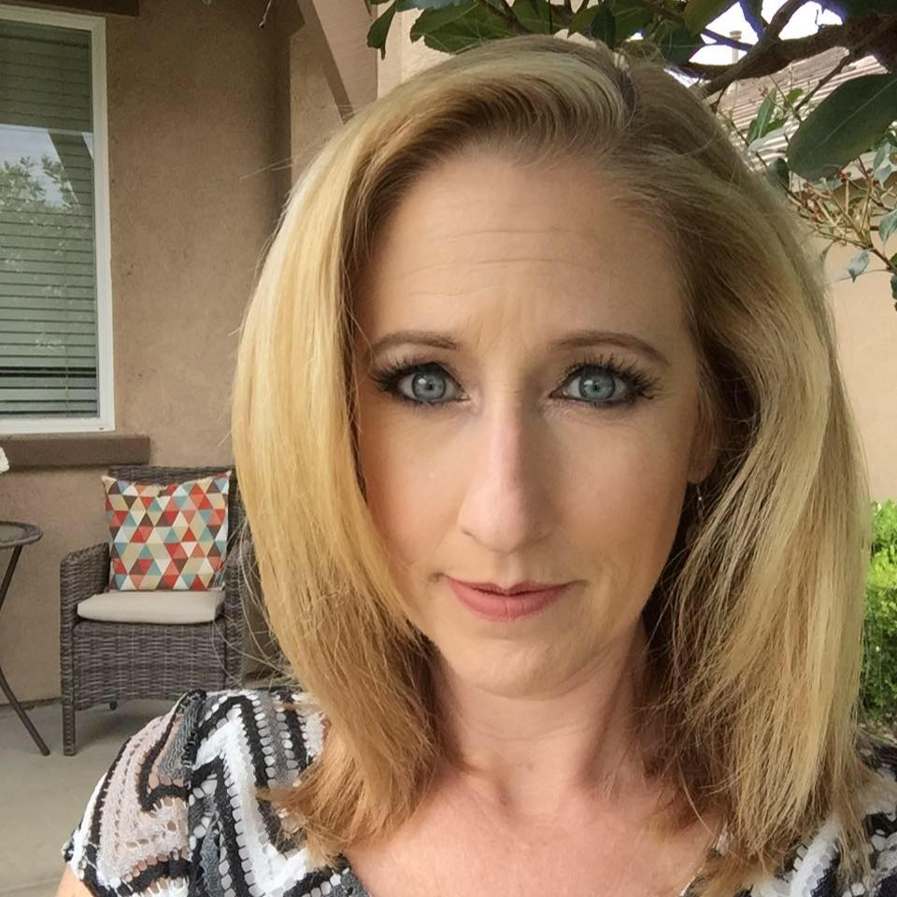


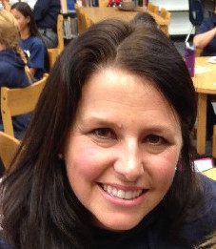
My Math Coaching Experience

Slide 8

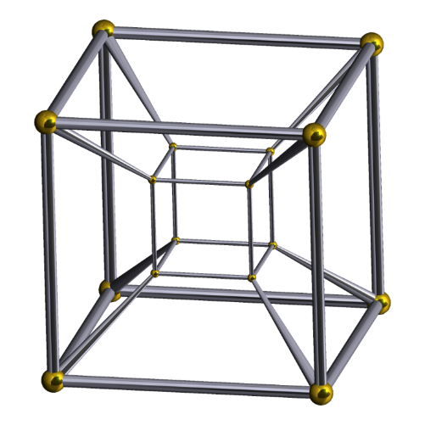








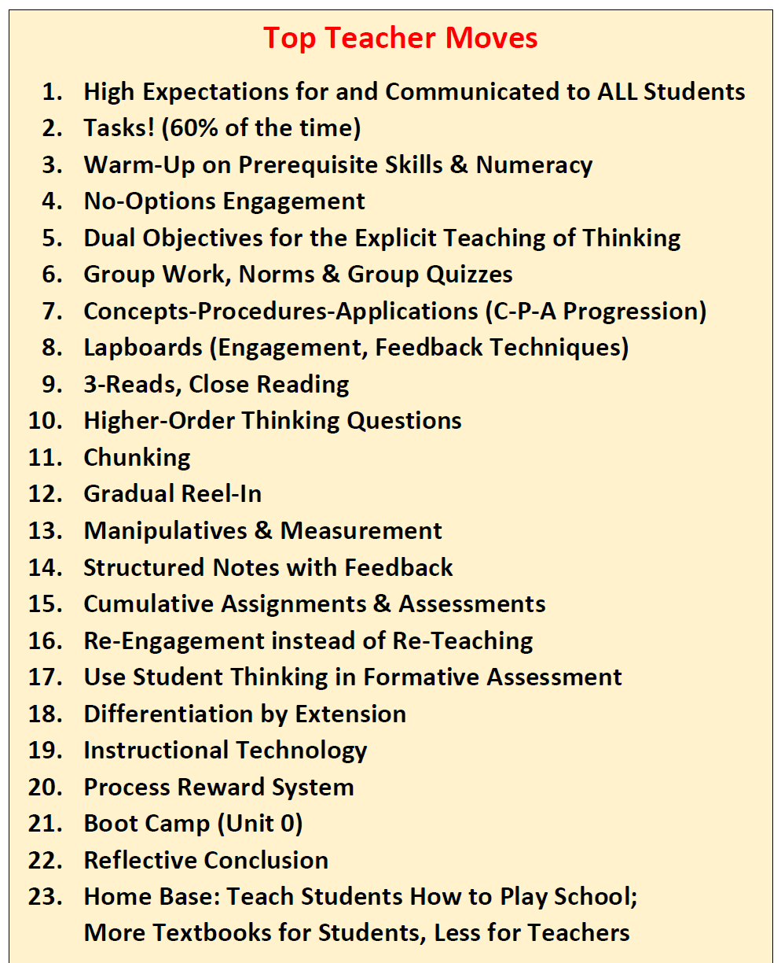
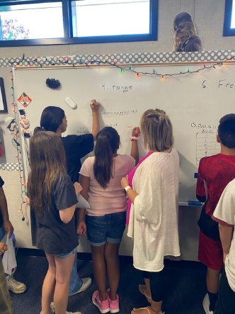

My Current Reality

Slide 9
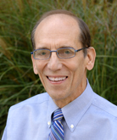
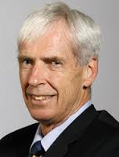
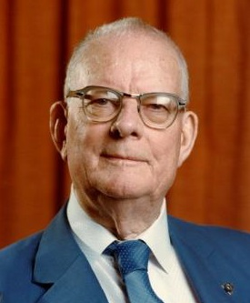
Our Key Principles
Students don’t improve until Teachers improve.
-- Dr. William Schmidt, University of Michigan
Teachers don’t improve until Leaders improve.
-- Dr. Kenneth Leithwood, University of Toronto
Our Systems are producing the exact results they are designed to get.
-- Dr. W. Edwards Deming

Slide 10
Our Agenda
Your Teachers
H.O.T. Tasks (that require productive struggle)
Group Work
The Principles of Discourse
Your Leadership
Textbook Resources
Coaching Tips
Your Systems
The Process Standards
Your Common Assessments

Slide 11

Your Teachers

Slide 12

Tasks
What is a Task?
40%
Notes
&
Drill
60%
“A mathematical task is a problem or set of problems that focuses students’ attention on a particular mathematical idea and/or provides an opportunity to develop or use a particular mathematical habit of mind.”
-- Adding it up (2001)

Slide 13
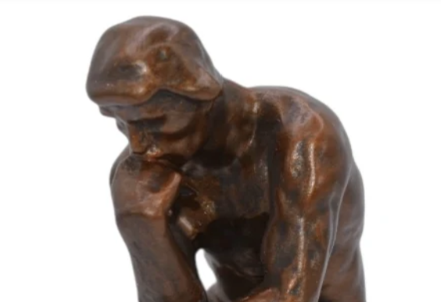
Tasks
What is a Task?
“a problem that provides an opportunity to develop mathematical ideas and [thinking].”
-- Adding it up (2001)
Tasks = Problems used to teach Content & Critical Thinking

Slide 14



Defining ‘Problems’
Don’t Know How
Don’t Have the Ability
Don’t Know How
Have the Ability
Know How
Have the Ability
Exercise
Problem
Crisis

Slide 15
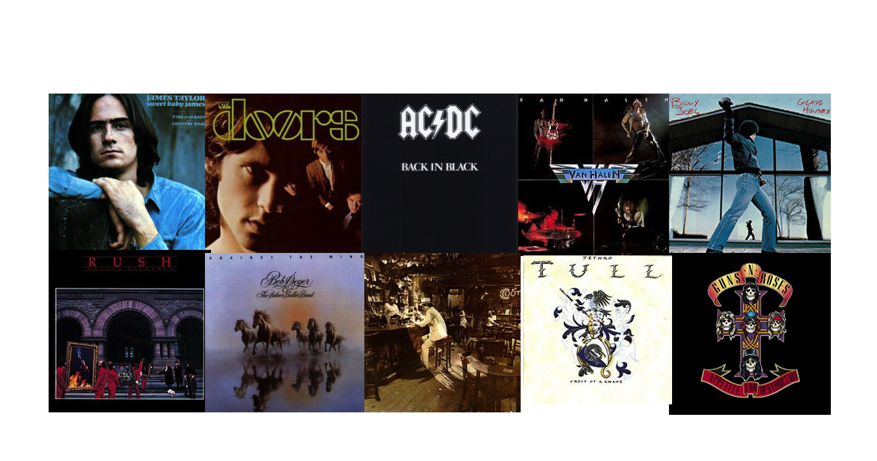
Task #1: Facebook Warm-Up
Day 1 of 10. In no particular order, share 10 of your all-time favorite albums that really made an impact and are still on your rotation list, even if only now and then. Post the cover, no need to explain, and nominate a person to do the same (a different person everyday). I nominate ....
Kelly ... If Robin asks 10 people who then ask 10 people etc... how many rounds will it take before the whole world (7 Billion People) is posting album covers on Facebook?

Slide 16
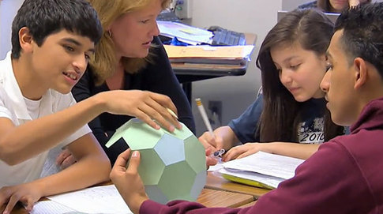
Making Group Work Work with Less Work
The Basic Questions…
Why Group?
Which Group Structures?
How to Manage Groups?
When to Group?

Slide 17
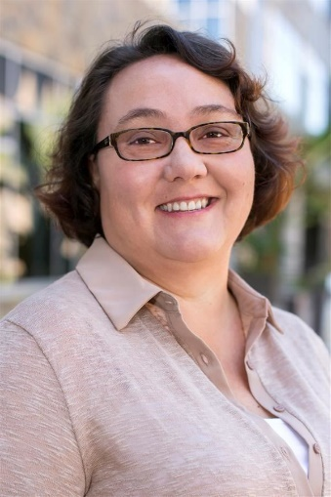

To Group or not to Group?
Dr. Rachelle Feiler
Research-Affirmed

Slide 18
To Group or not to Group?
“Active Learning is the empirically validated teaching practice in regular classrooms,”
Active learning is defined as “engages students in the process of learning through activities and/or discussion in class, as opposed to passively listening to an expert. It emphasizes higher-order thinking and often involves group work.”
--National Academy of Sciences, Scott Freeman, 2013
Research-Affirmed

Slide 19

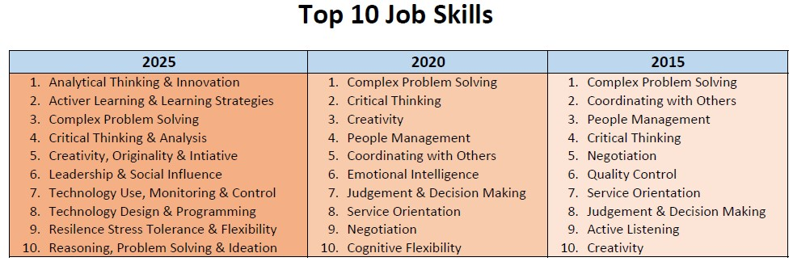
To Group or not to Group?
The 4C’s:
Critical Thinking, Communication, Collaboration, Creativity

Slide 20
Why Group?
Research & the 4 C’s
claim that collaboration is
a means AND an end!

Slide 21
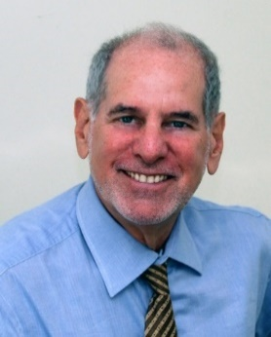

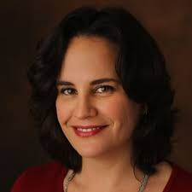
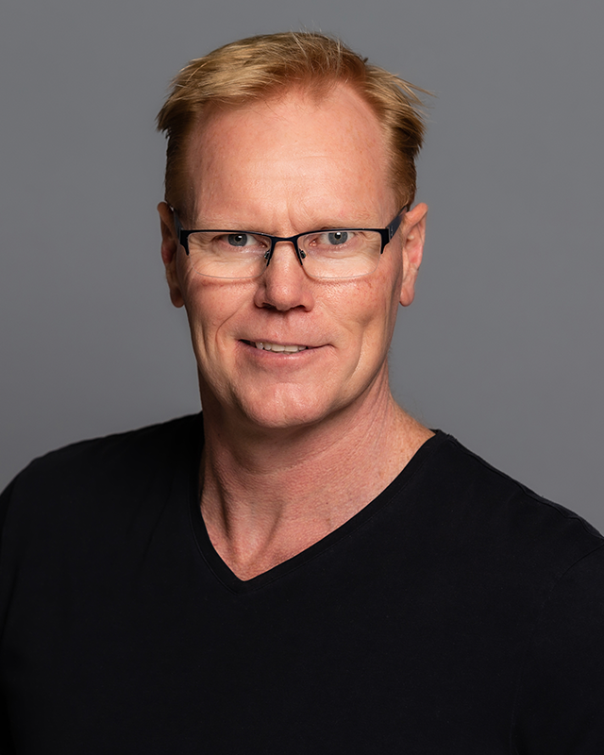
In Which Structures to Group?
Task = Group Worthy
Homogenous
Heterogeneous
Random
Visibly
Random

Slide 22

How to Manage Groups?
Norms
Vigilance
Accountability
I will explain my thinking.
I will listen to the thinking of others
I will say something if I don’t understand or agree.
________________

Slide 23


When to Group?
Notes-Oriented
Task-Oriented
40%
60%
most
Start with 1 task per unit.

Slide 24
Making Group Work Work with Less Work
Why Group?
R______, & F______
Which Group Structures?
H___________, H__________, R_____,
How to Manage Groups?
N____, V______, A_________
When to Group?
  M___________
esearch
our C’s
eterogeneous
omogeneous
andom
orms
igilance
ccountability
ost of the time

Slide 25


Task #2: Breath Mint Equation
$$K = 2M + 1$$
M
2
2M
1
2M + 1

Slide 26
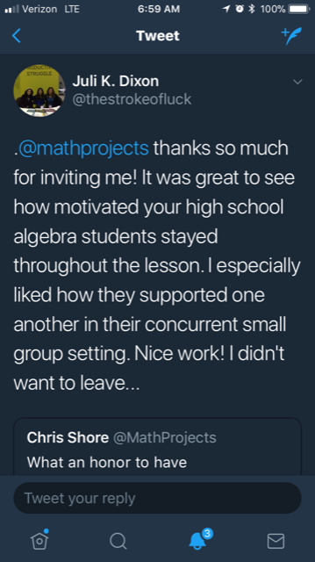
Mr. Shore’s Math Community
“It was nice to see how enthusiastic your students were about the math they were doing.”
“We got to spend an hour watching young mathematicians at work. That was awesome.”

Slide 27




Break
10 minutes, until we...
Improve your
leadership and systems.

Slide 28


Behavior in the Open Classroom

Slide 29
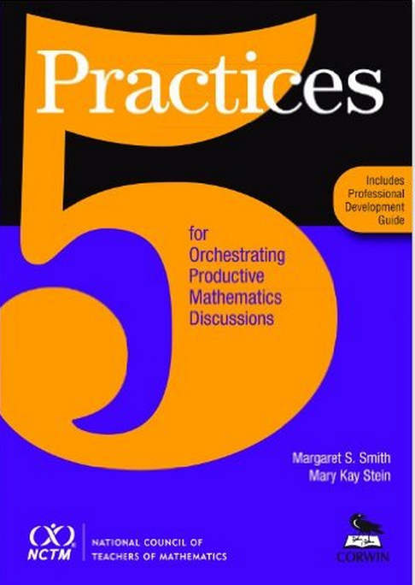
5 Practices
Anticipating
Monitoring
Selecting
Sequencing
Connecting

Slide 30

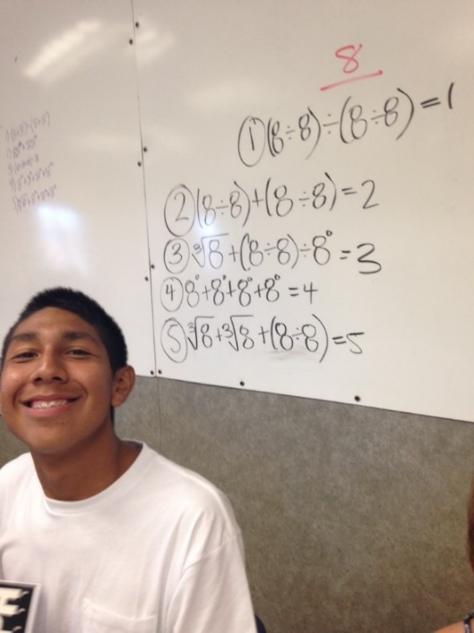
Task #3: : -Digit Problem
8 + 8 + 8 + 8 = 32
8²/8 + 88 = 96
Arrange four 8’s to create the value 19.
88 ÷ 8 + 8
³
8 + 8 + √ 8 + 8⁰

Slide 31
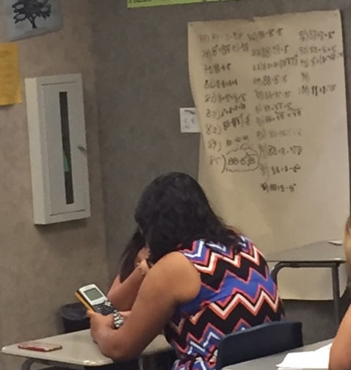
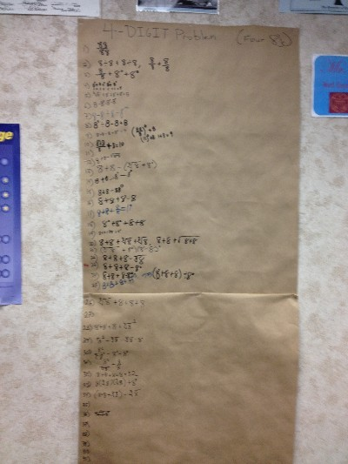
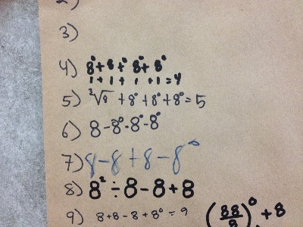
Task #3: : -Digit Problem

Slide 32
Debrief
Anticipating
Monitoring
Selecting
Sequencing
Connecting

Slide 33
Your Teachers
H.O.T. Tasks
Group Work
5 Practices of Mathematical Discussion

Slide 34

Your Leadership

Slide 35
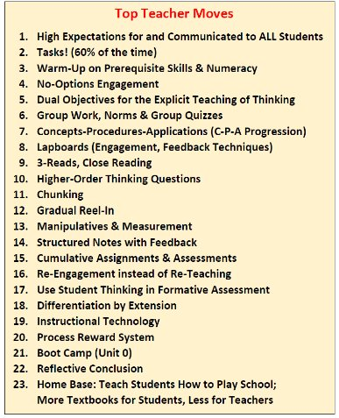
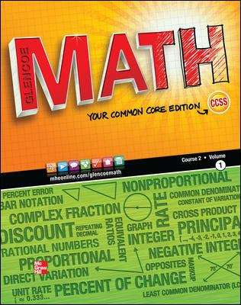

Use the Textbook Tasks

Slide 36

Coaching the Tasks

Slide 37
Your Leadership
Textbook Tasks
Coach the Tasks

Slide 38

Your Systems

Slide 39
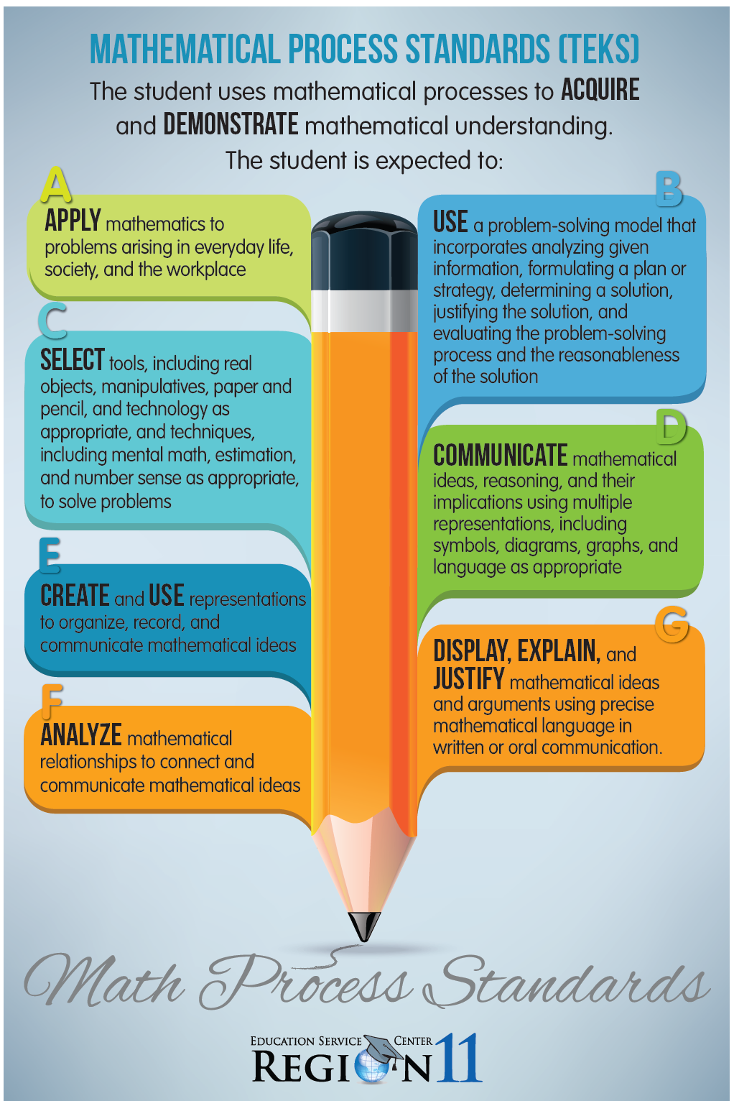
Process Standards

Slide 40

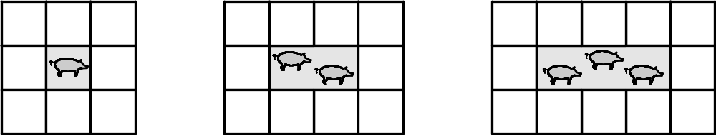
Task #4: Pig Pen Algebra

Slide 41
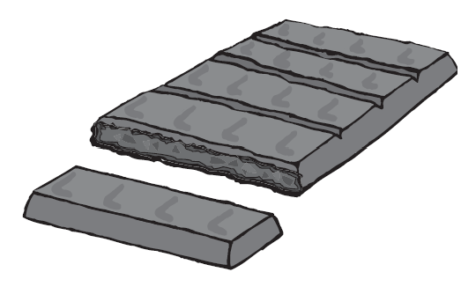
Task #4: Candy Bars & Fractions

Slide 42
Debriefs

Slide 43
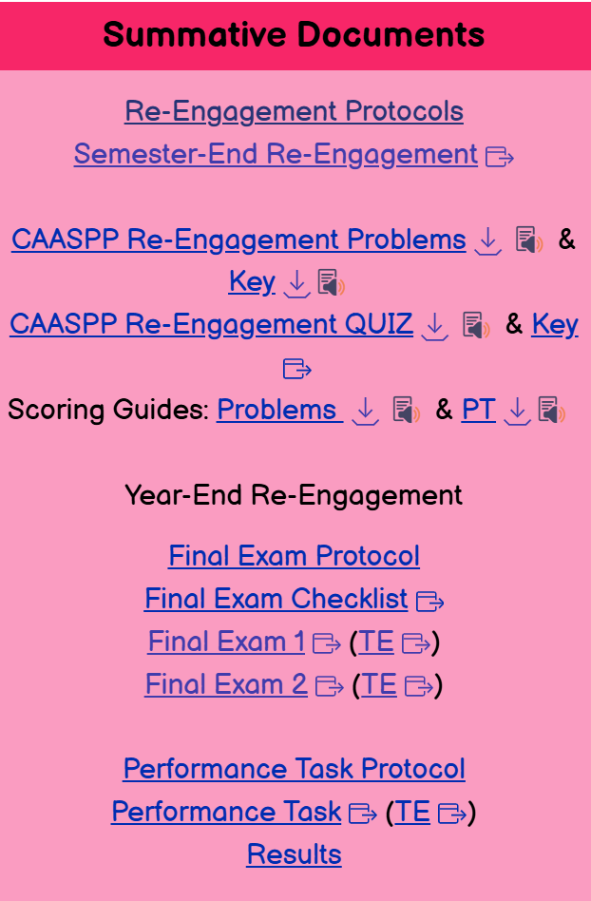
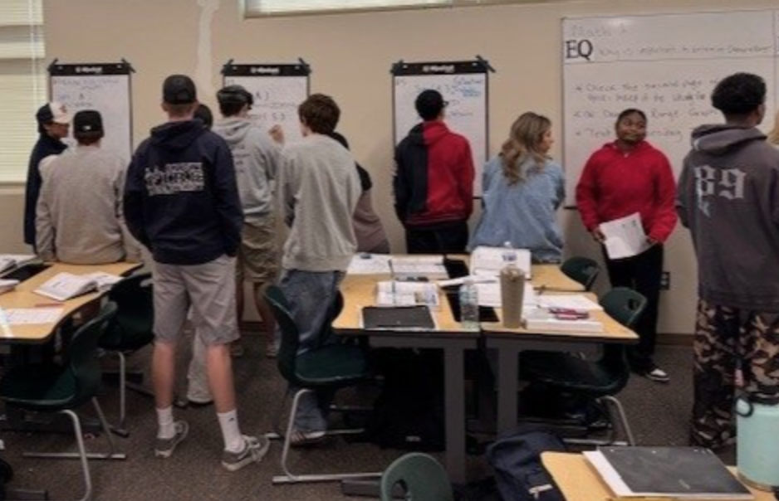

Provide Tasks

Slide 44



Spectrum of Coaching Effectiveness
Spectrum of what teachers want.
Resources Co-Teaching Teacher
Reflection
Spectrum of what works.
Dr. Maggie McGatha, University of Louisville, NCSM, Boston, 2015

Slide 45


Rigor of Your Common Assessments

Slide 46
Your Systems
Emphasis on the Process Standards
Rigorous Common Assessments

Slide 47

Recap
Individually
Resourcefully
Collaboratively

Slide 48

Recap
Themselves & Teachers
Themselves & Students
Teachers Improve.
Leaders Improve.
they were designed to get.

Slide 49

Recap
ability
don’t know how
Content Critical Thinking
Research & The 4 C’s
Homogenous, Heterogeneous, Random
Norms, Vigilance & Accountability
Most of the Time

Slide 50

Recap
Anticipate Sequence
Monitor Connect
Select
Apply Communicate
Use Create
Select Display
Analyze

Slide 51

Recap
Textbook
1
1 new thing every 2 weeks
Process Standards
Provide Tasks
Rigorous Common Assessments

Slide 52

Our Agenda
Your Teachers
H.O.T. Tasks
Group Work
The Principles of Discourse
Your Leadership
Textbook Resources
Coaching Tips
Your Systems
The Process Standards
Your Common Assessments

Slide 53

Your Big Take-Away

Slide 54


Call to Action: Your Next Step
50%
25%
25%

Slide 55
Our 3 Principles

Slide 56

Lead Your Teachers to H.O.T.S. …
… with Tasks, Struggle & Discourse…
… so we can change this world,
one math lesson at a time.

