Slide 1
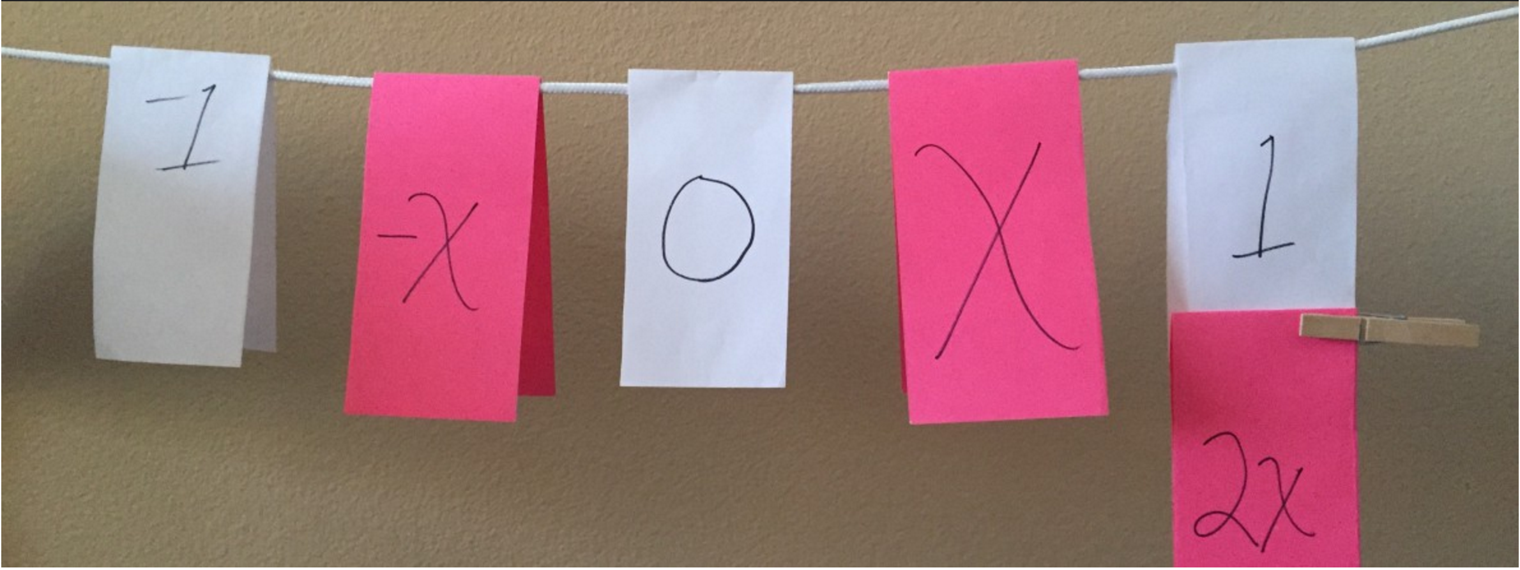


Clothesline Math
Algebra, Geometry & Statistics
The Master Number Sense Maker!
Chris Shore
The Math Projects Journal
Murrieta Valley USD
mathprojects.com
clotheslinemath.com
@MathProjects
#clotheslinemath
#nwmath2024

Slide 2

Clothesline Math
Our Objectives Today
Model Clothesline Math Lessons
Declare your first steps to implementing your own Clothesline Math Activity
@MathProjects #clotheslinemath
Notes:
10:35

Slide 3
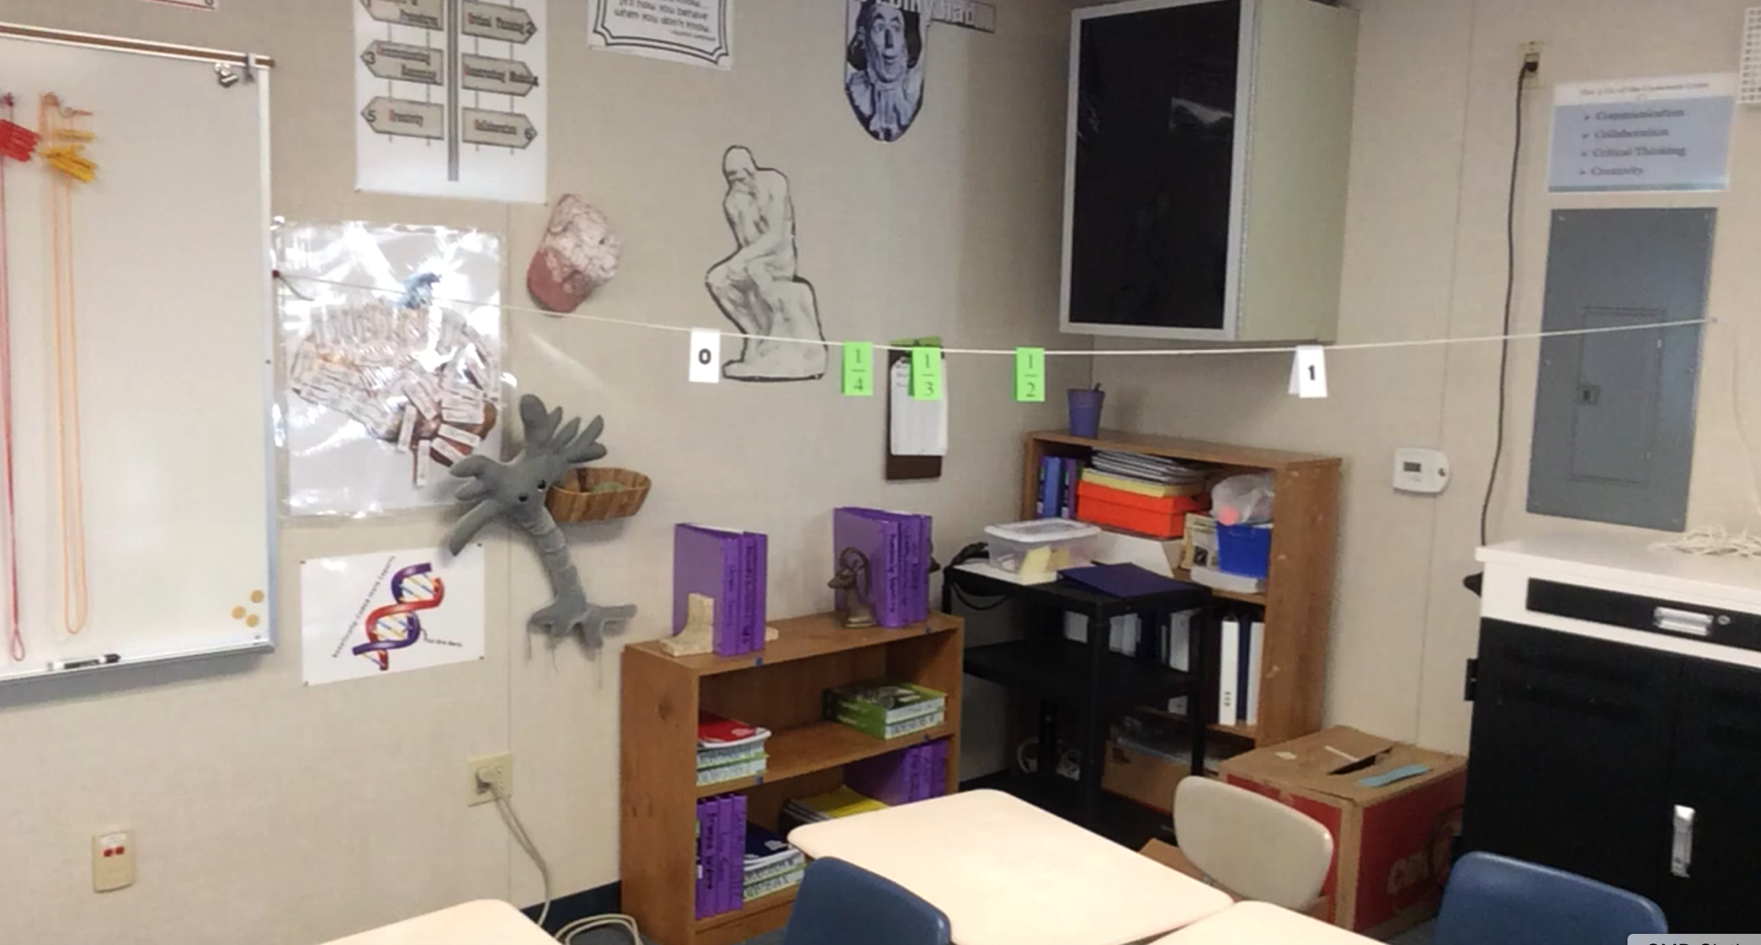
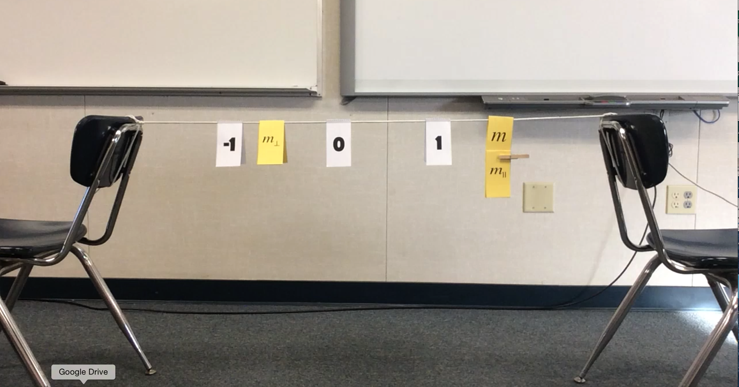
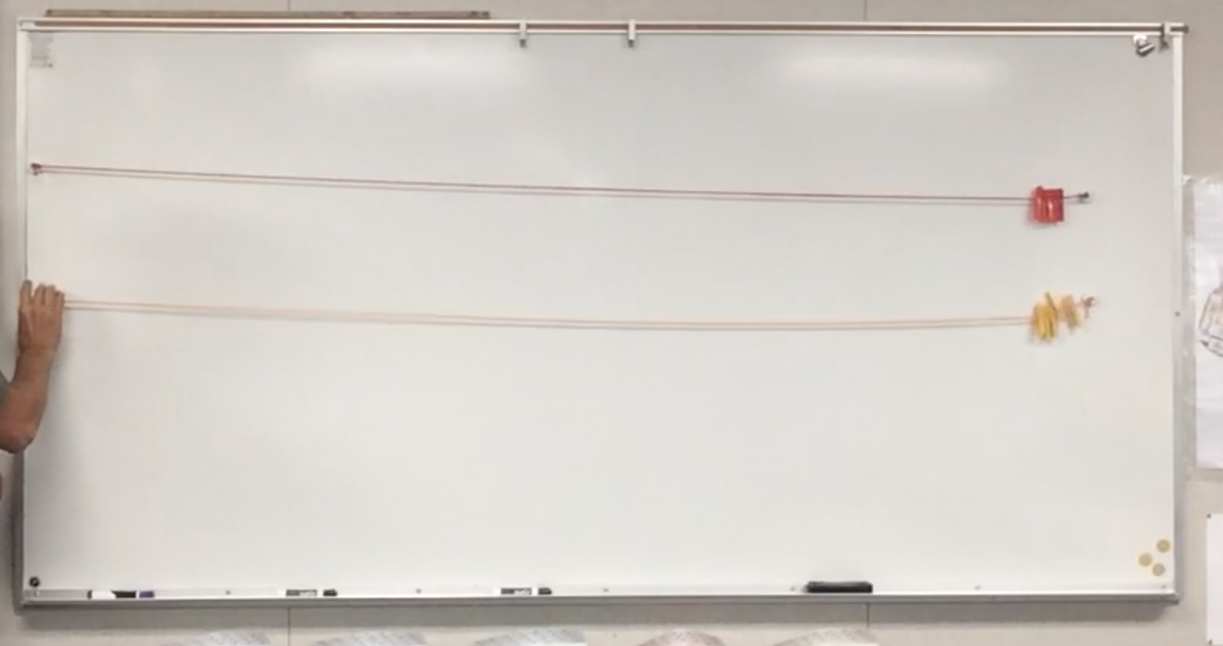
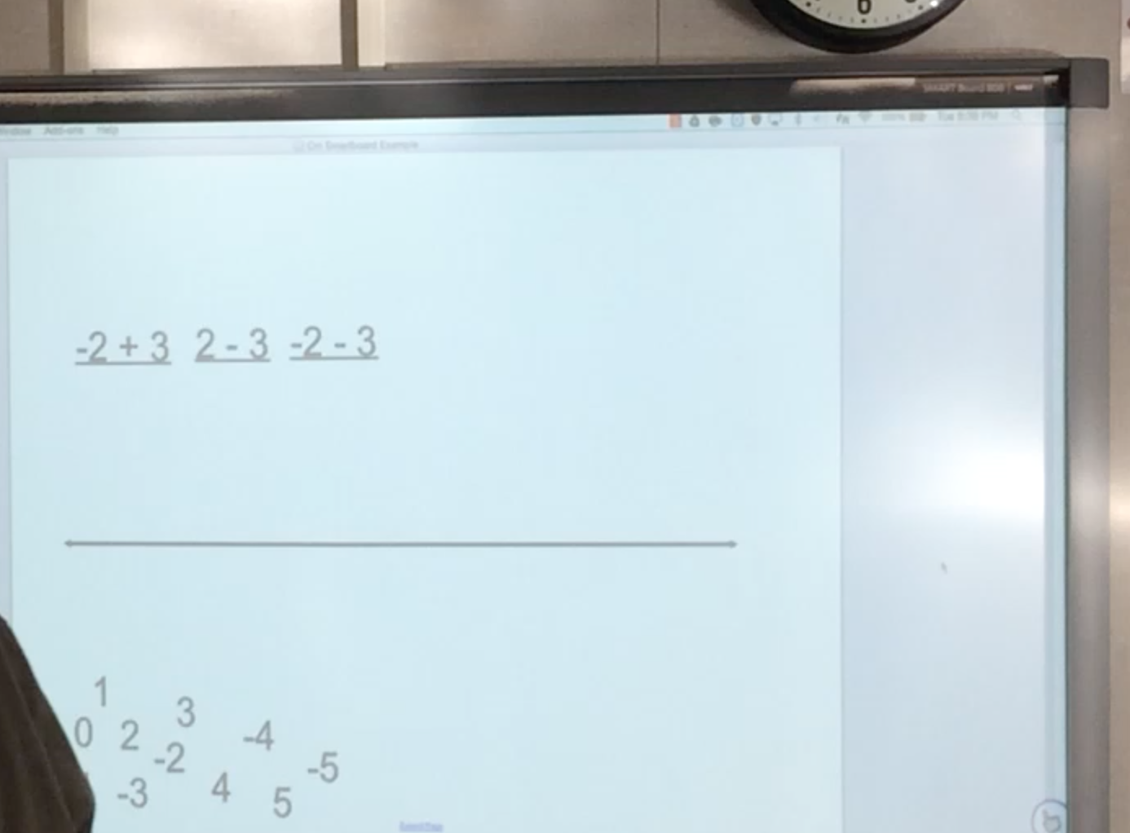
Clothesline Math
The Set-up
@MathProjects #clotheslinemath
Notes:
10:35

Slide 4
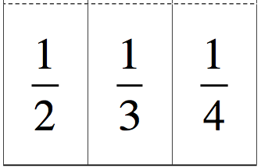
Clothesline Math
Introduction
@MathProjects #clotheslinemath
Notes:
10:40

Slide 5
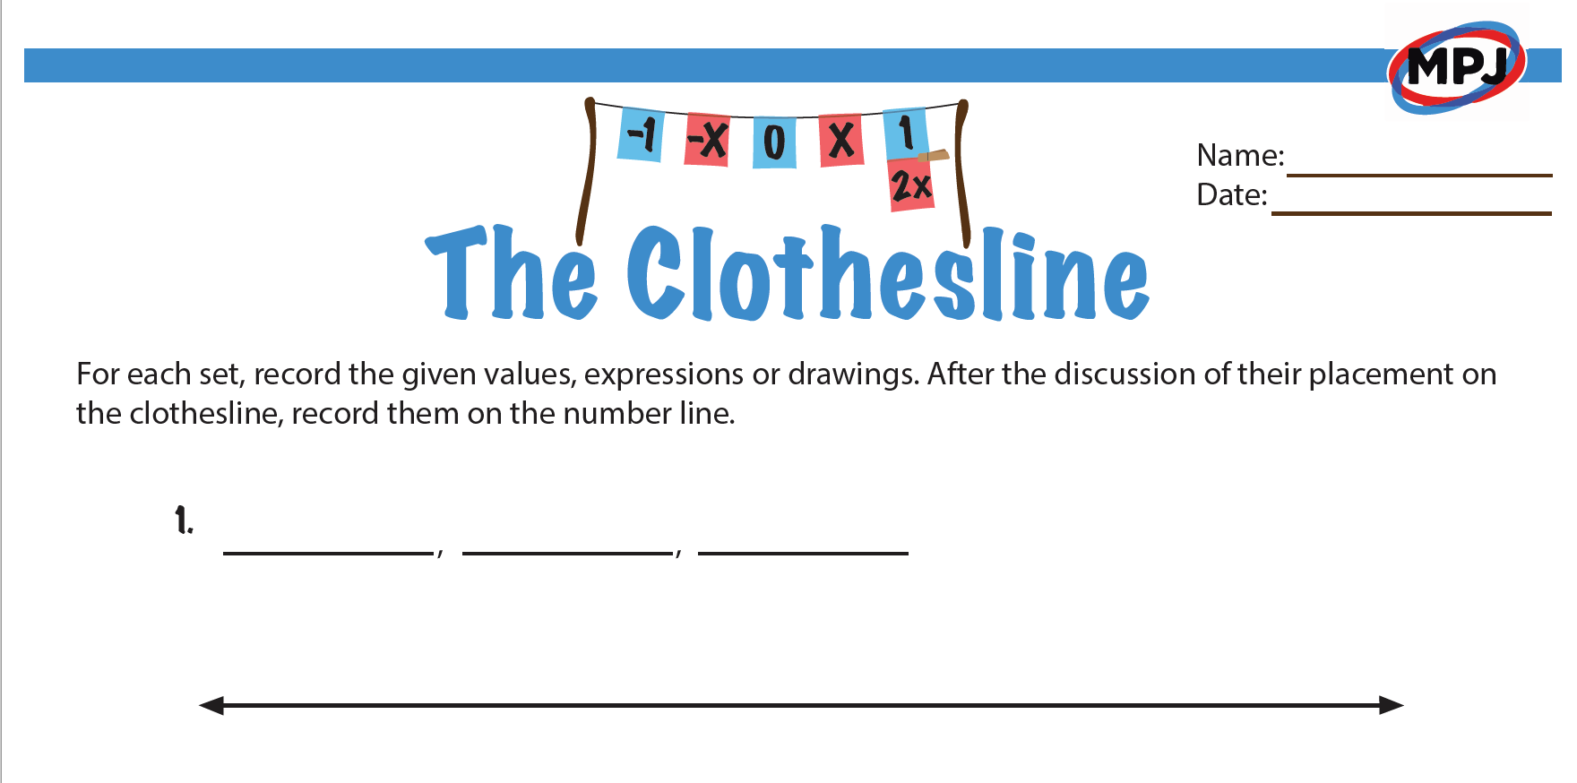
Clothesline Math
Handout
Discussions, Deductions & Decisions
@MathProjects #clotheslinemath
Notes:
10:40

Slide 6
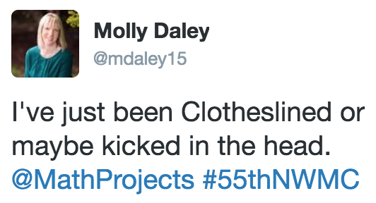
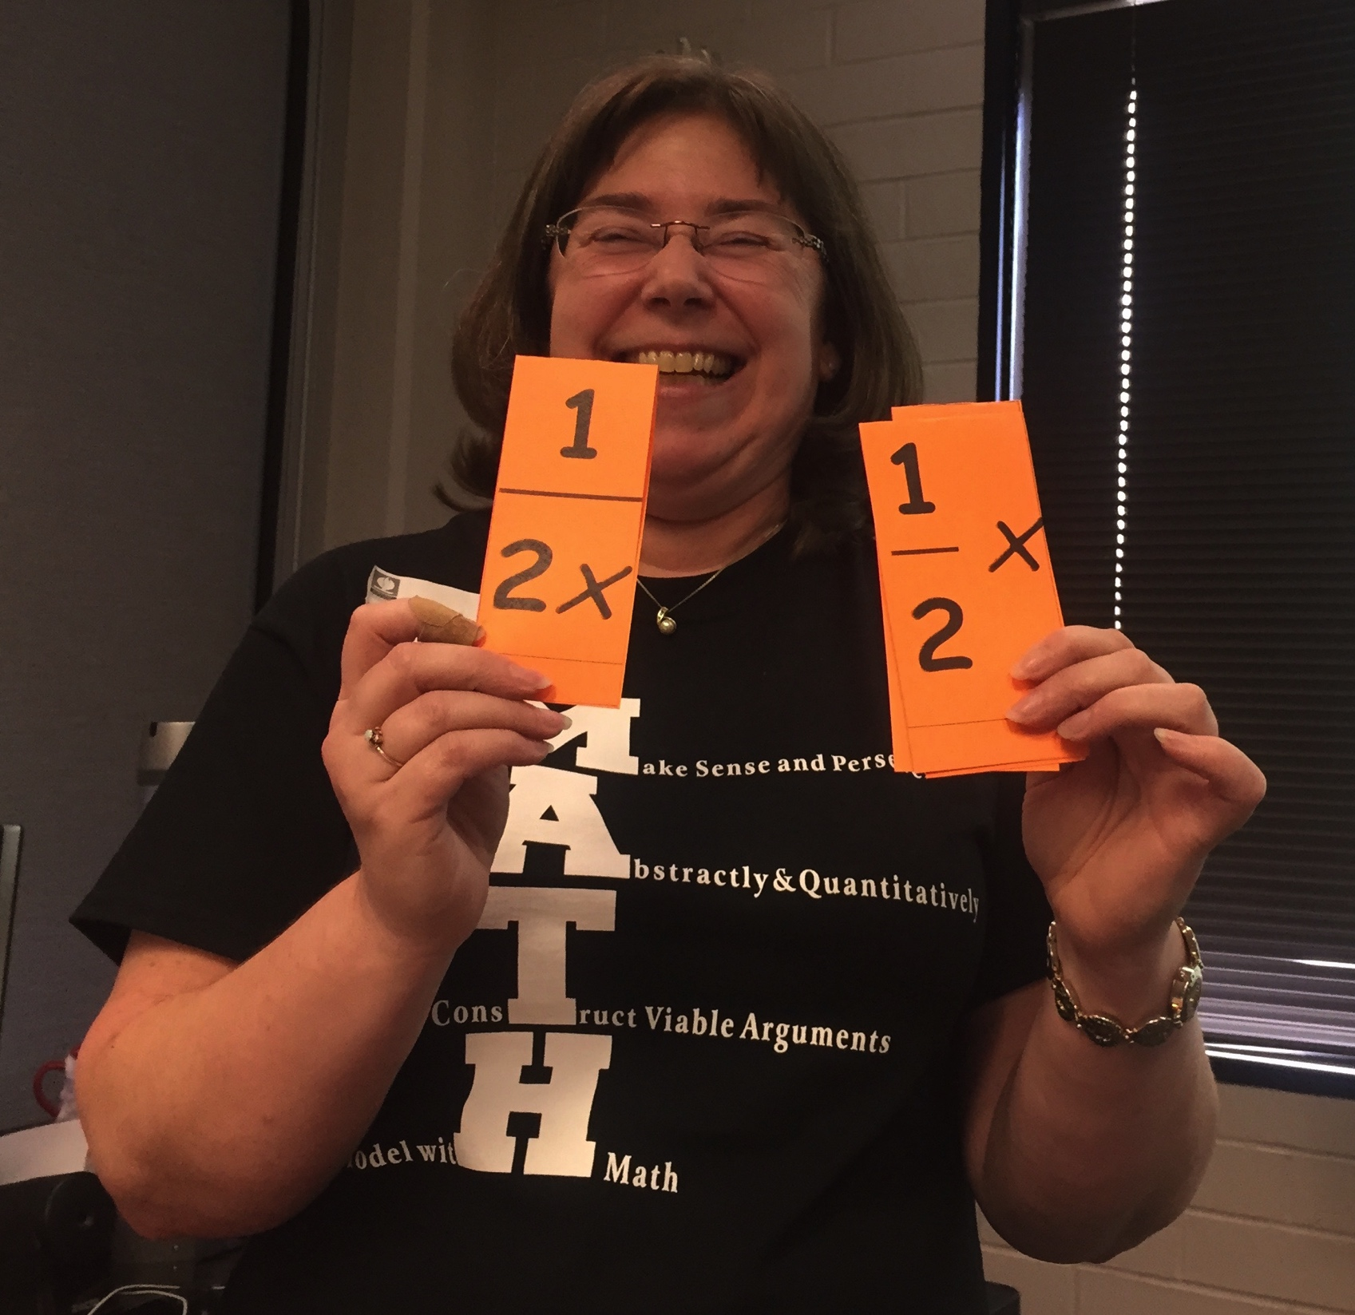
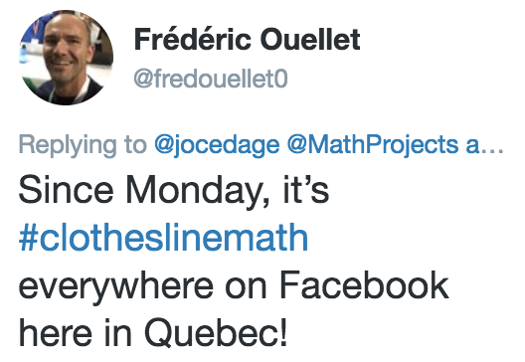
Clothesline Math
A Brief History
Notes:
10:35

Slide 7
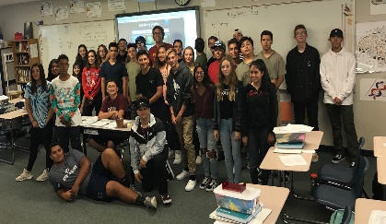
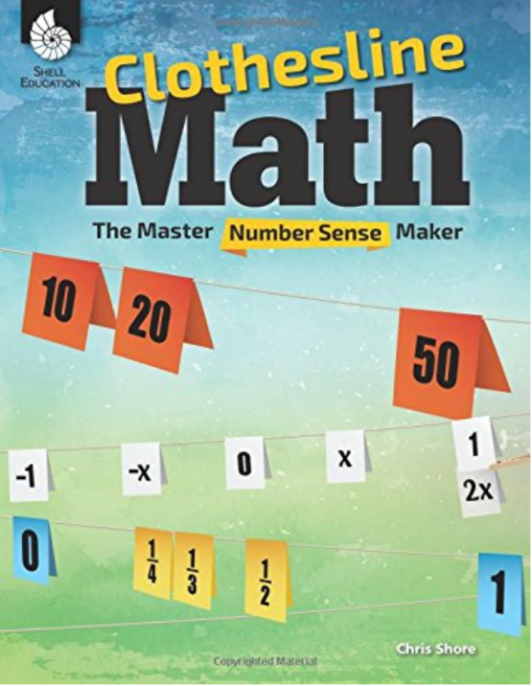
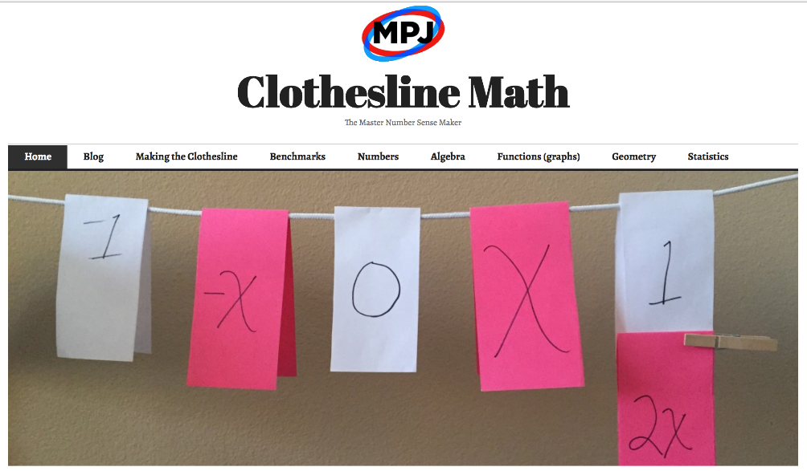
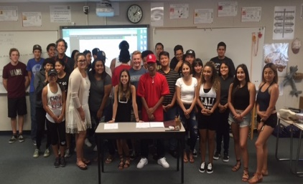
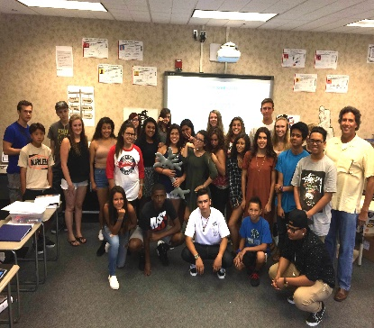
Clothesline Math
My Contributions
#clotheslinemath
@MathProjects #clotheslinemath
Notes:
10:35

Slide 8
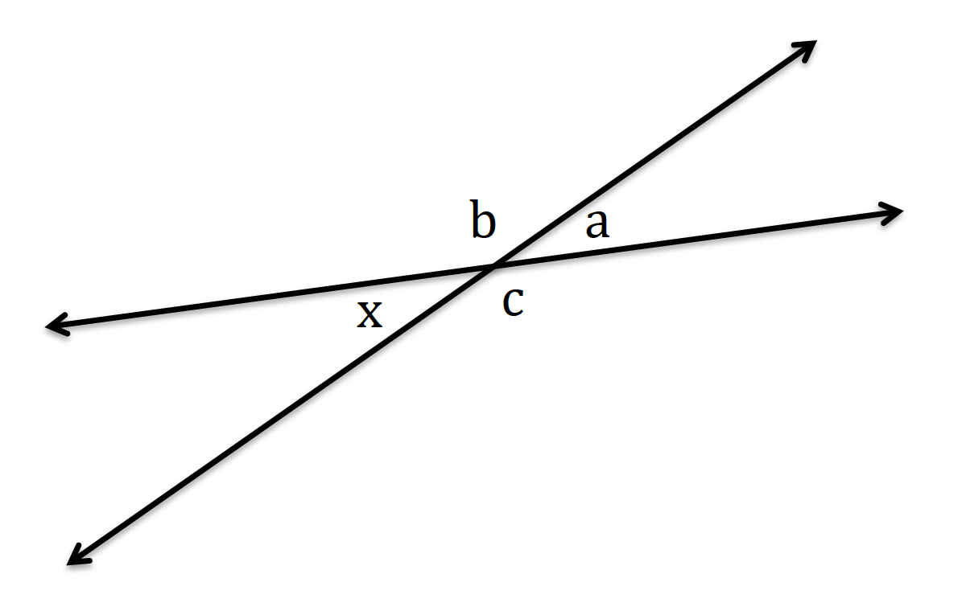
Clothesline Math
Geometry
G.CO.9: See the structure of vertical angles and linear pairs to prove that vertical angles are congruent.
a, b,
c,
x
@MathProjects #clotheslinemath

Slide 9
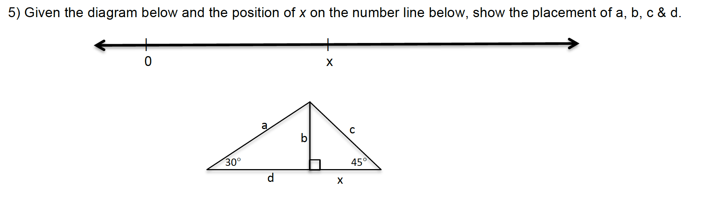
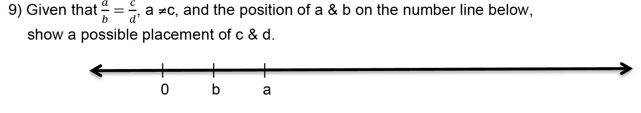
Clothesline Geometry
Assignments & Assessments

Slide 10
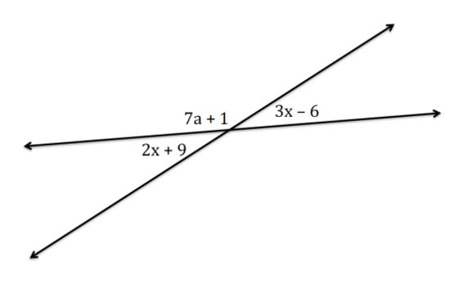
Clothesline Math
Geometry with Algebra
A.REI.1: Solve equations with variables on both sides to determine the measure of vertical angles.
3x – 6 = 2x + 9
-2x = -2x
x – 6 = 9
+ 6 = +6
x = 15
2x + 9, 3x – 6,
2x, 3x,
x
@MathProjects #clotheslinemath

Slide 11
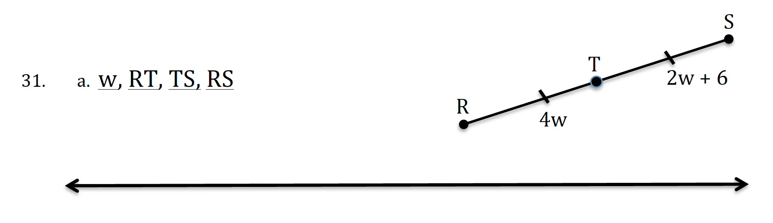
Clothesline Geometry
Assignments & Assessments
@MathProjects #clotheslinemath
Notes:
11:15
SINGLE

Slide 12

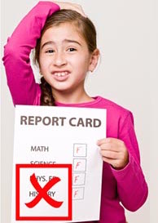

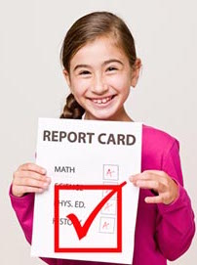
Clothesline Math
The Need for Number Sense
Build Number Sense…
…intentionally!
@MathProjects #clotheslinemath

Slide 13
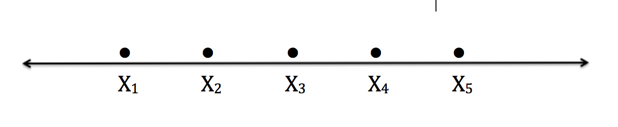
Clothesline Math
Statistics
S.ID.2: Reason abstractly to compare measures of center & spread between two data sets.
Same
Smaller
Same
Smaller
Smaller
Larger
Larger
Smaller
Smaller
Smaller
Same
Range
Standard Deviation
Average
@MathProjects #clotheslinemath

Slide 14

Clothesline Math
Reflection
Why Clothesline Math?
Landscapes for Learning
@MathProjects #clotheslinemath

Slide 15
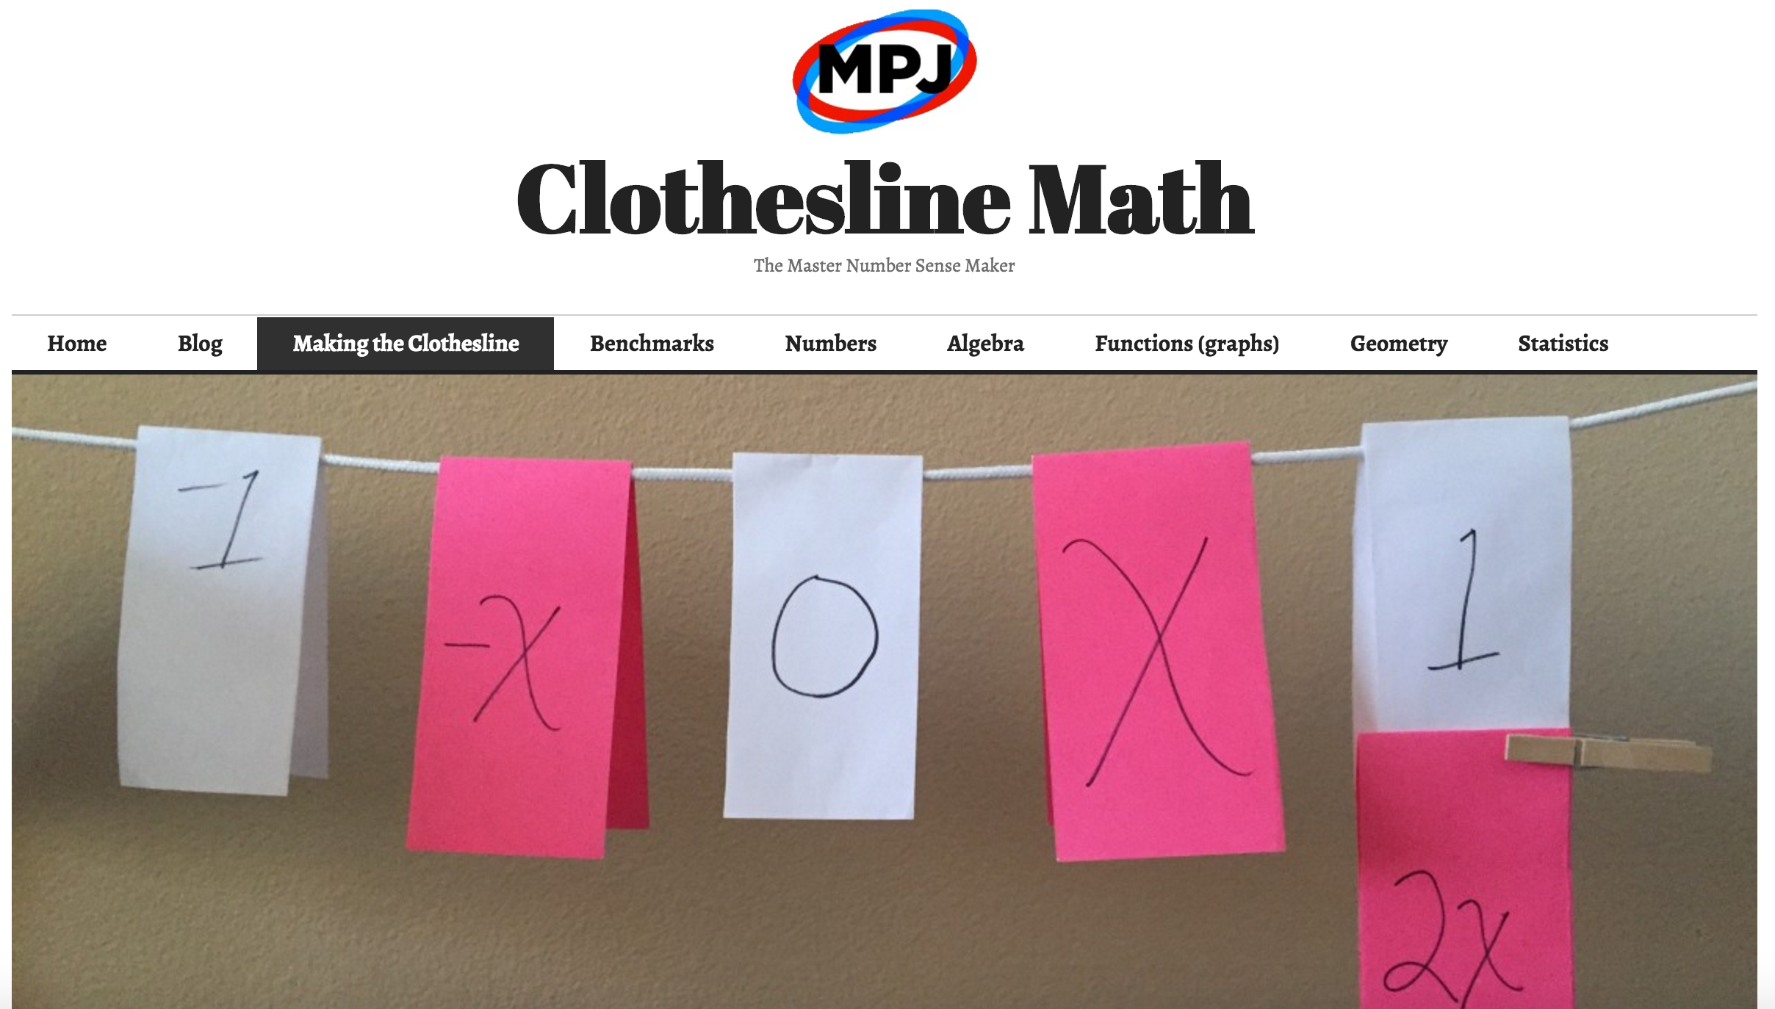
Clotheslinemath.com
Open Resource
@MathProjects #clotheslinemath

Slide 16
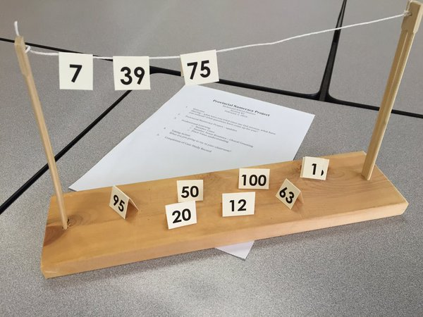
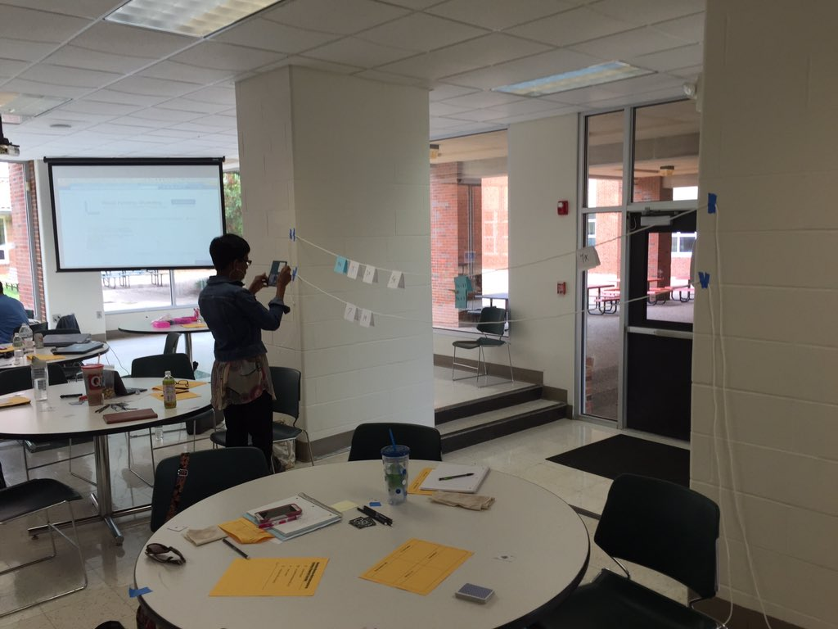
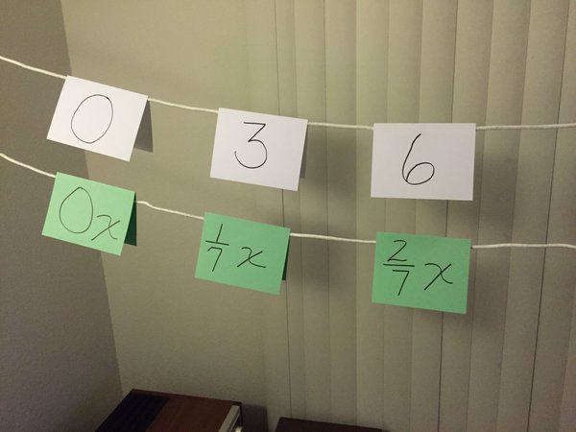
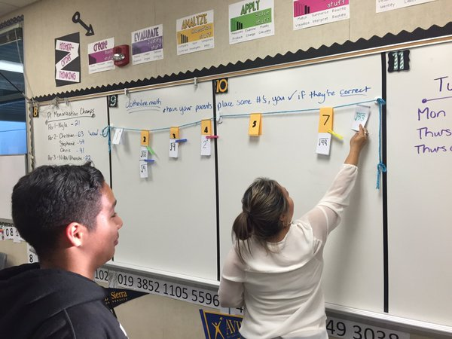
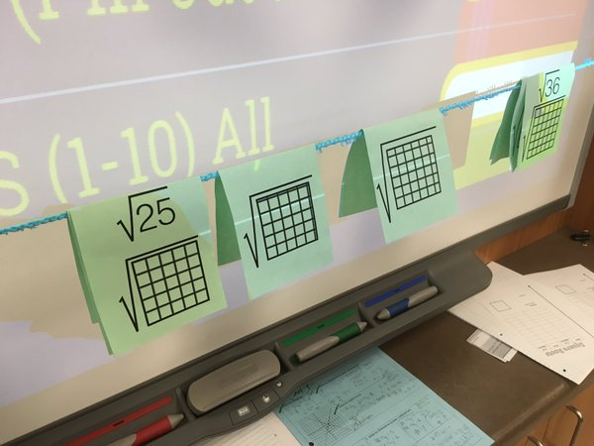
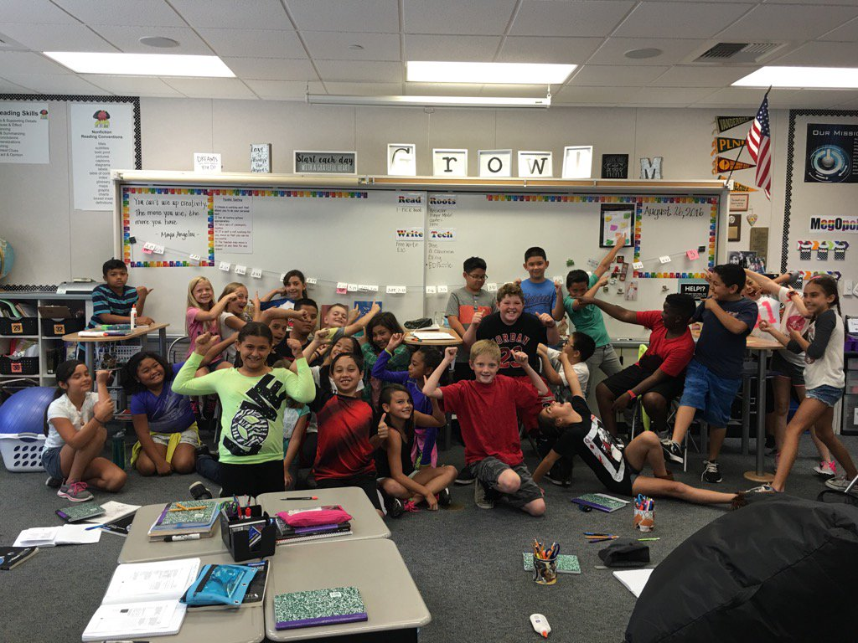
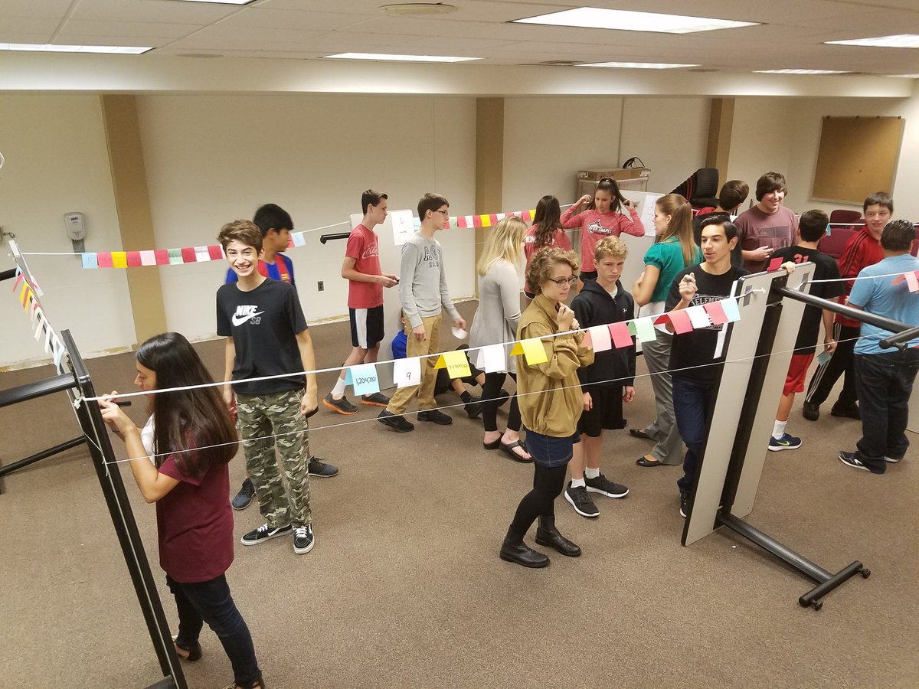
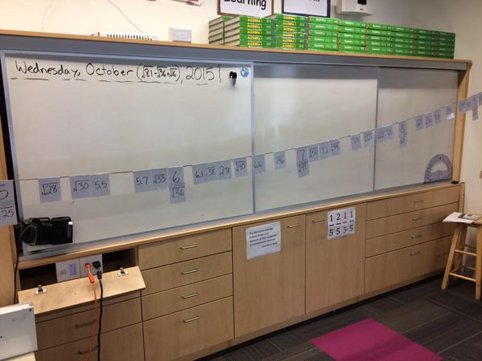
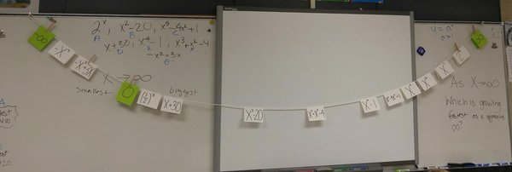
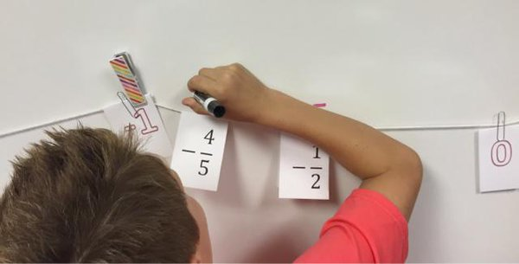
Clothesline Math
Around the World
@MathProjects #clotheslinemath

Slide 17



Clothesline Math
Call to Action
Fail Grandly
2-Week Rule
No Real Risk
10%
@MathProjects #clotheslinemath

Slide 18
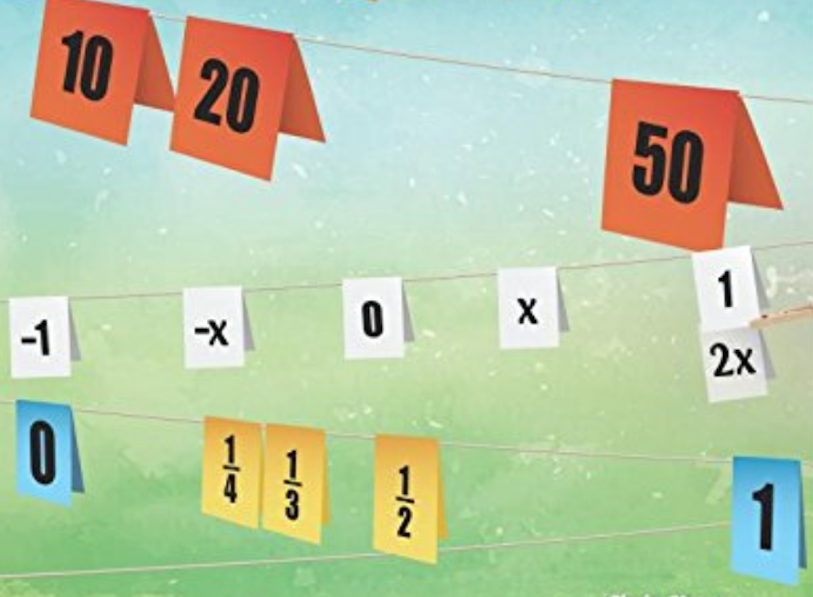
shore@mathprojects.com
clotheslinemath.com
…with the faith that they can learn it,
and that we can teach it to them,
…change the world,
one clothesline math lesson at a time.
@MathProjects #clotheslinemath

