Slide 1
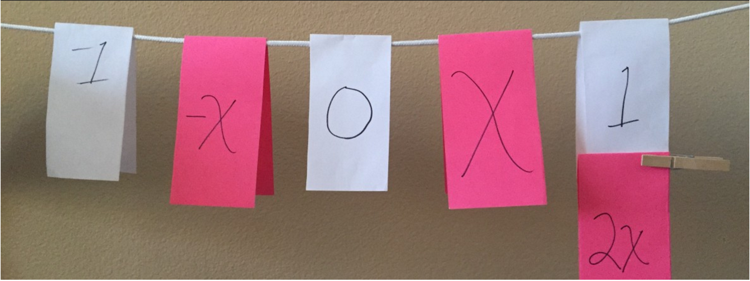


Clothesline Math
Algebra, Geometry & Statistics
The Master Number Sense Maker!
Chris Shore
The Math Projects Journal
Murrieta Valley USD
www.mathprojects.com
@MathProjects
#clotheslinemath
#CMCMath

Slide 2

Clothesline Math
Our Objectives Today
Model Clothesline Math Lessons
Declare your first steps to implementing your own Clothesline Math Activity
@MathProjects #clotheslinemath
Notes:
10:35

Slide 3
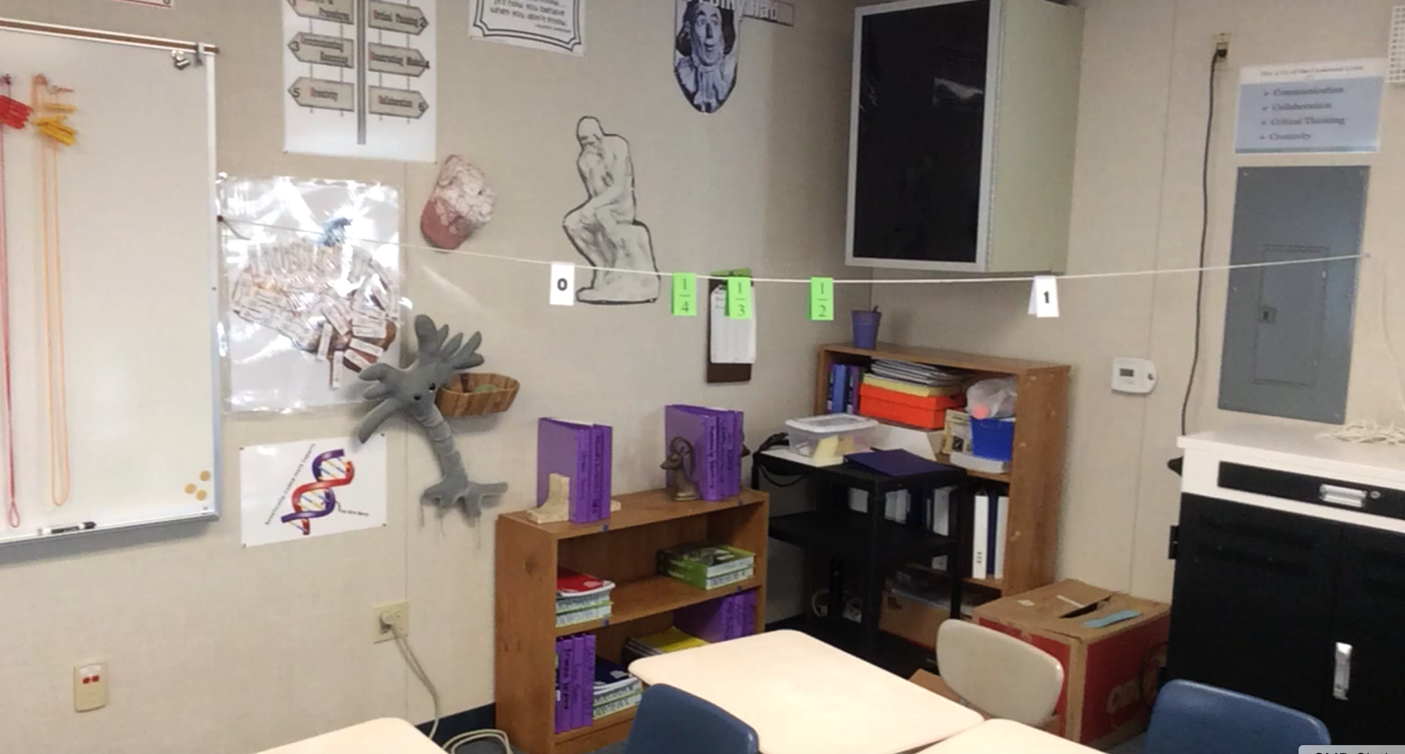
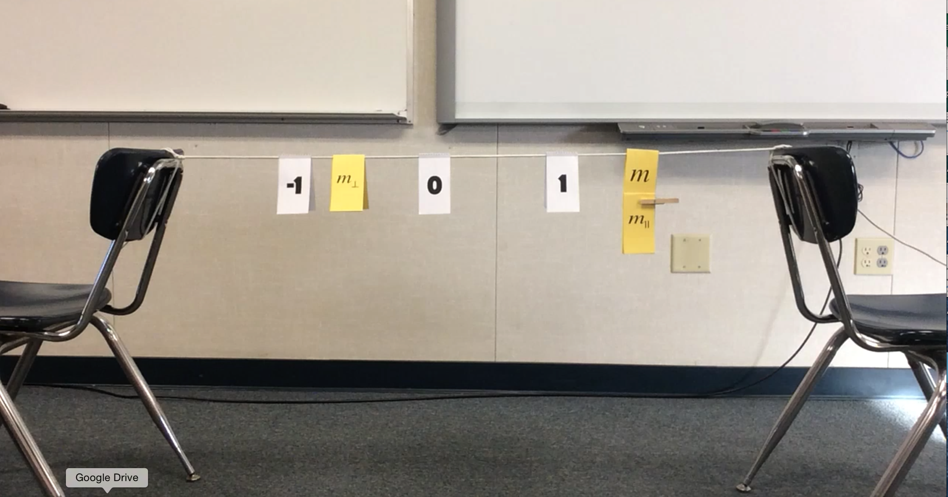
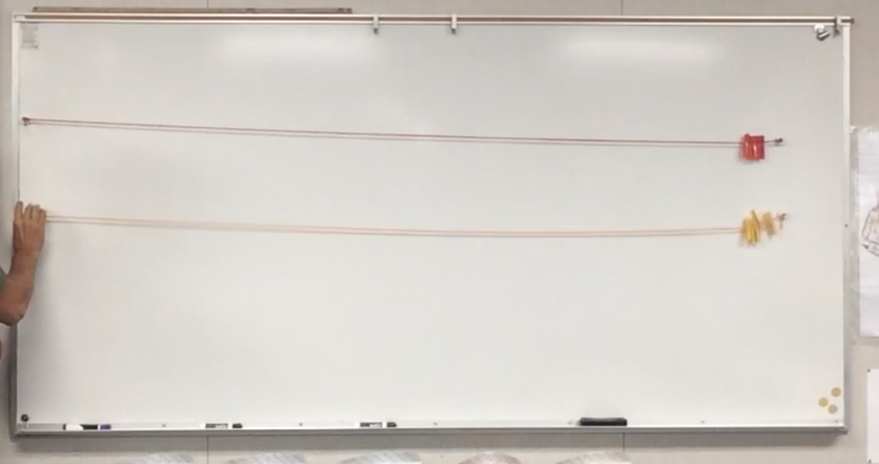
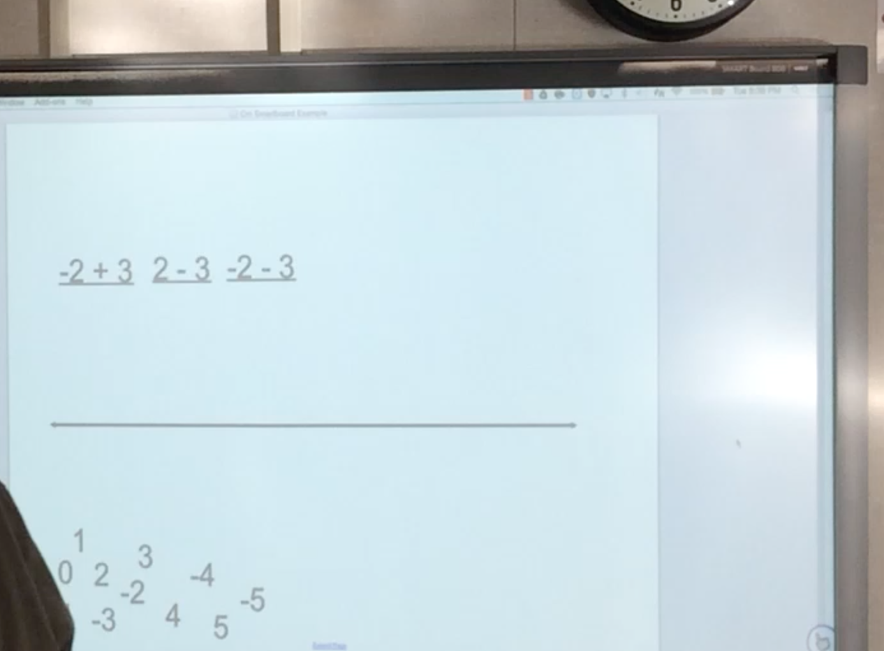
Clothesline Math
The Set-up
Notes:
10:35

Slide 4
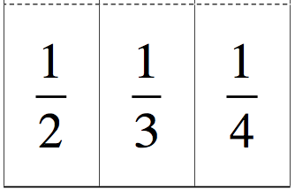
Clothesline Math
Introduction
@MathProjects #clotheslinemath
Notes:
10:40

Slide 5
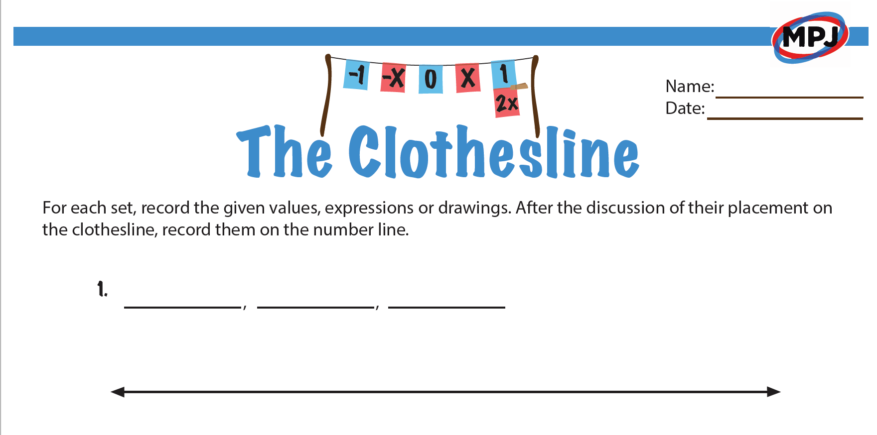
Clothesline Math
Handout
Discussions, Deductions & Decisions
@MathProjects #clotheslinemath
Notes:
10:40

Slide 6
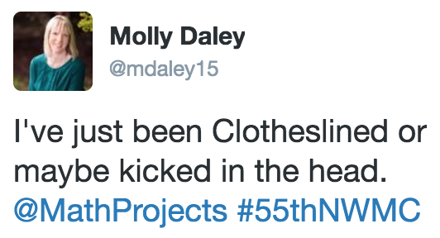
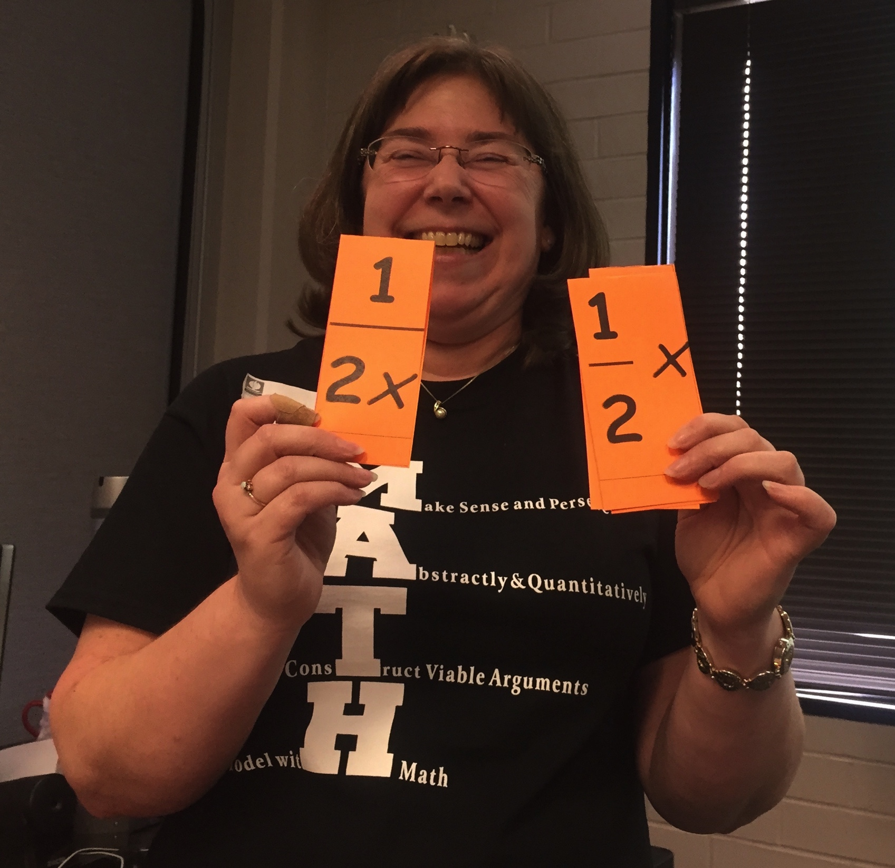
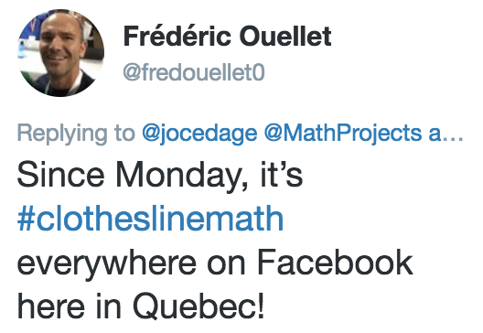
Clothesline Math
A Brief History
@MathProjects #clotheslinemath
Notes:
10:35

Slide 7
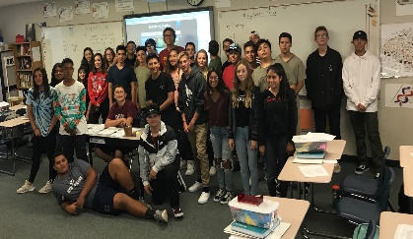
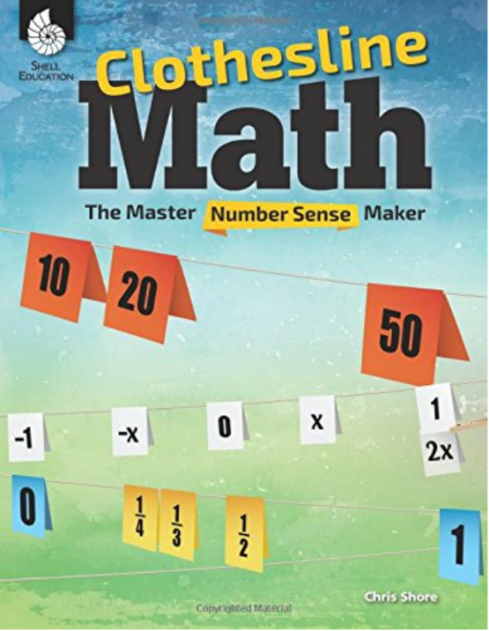
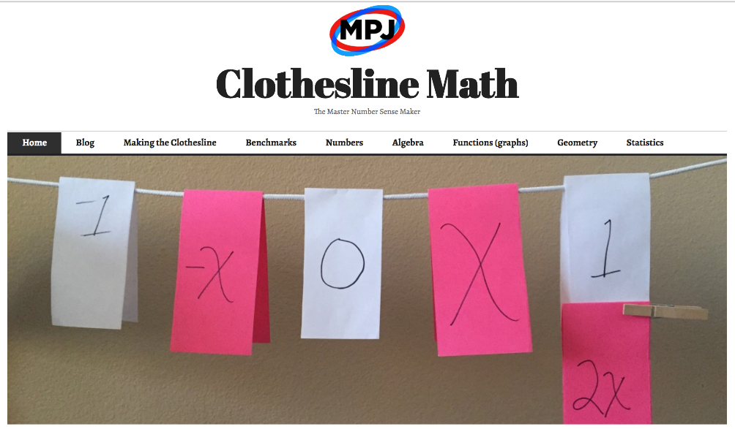
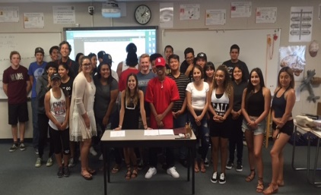
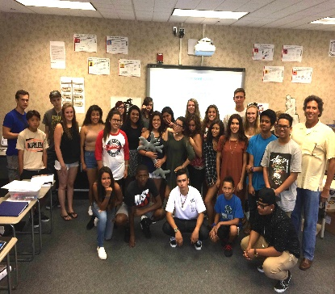
Clothesline Math
My Contributions
#clotheslinemath
@MathProjects #clotheslinemath
Notes:
10:35

Slide 8
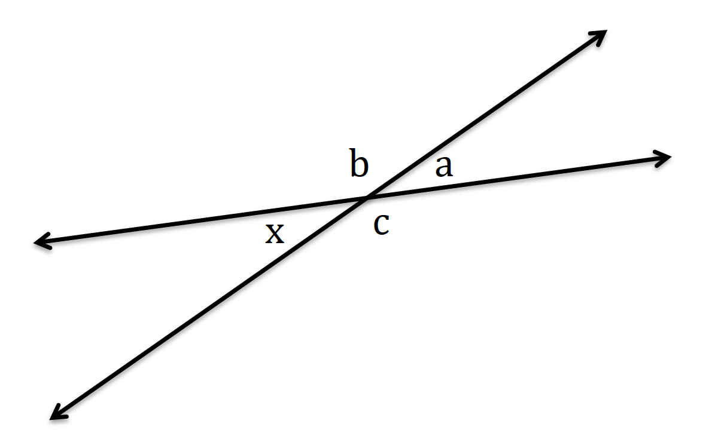
Clothesline Math
Geometry
G.CO.9: 1See the structure of vertical angles and linear pairs to prove that vertical angles are congruent.
a, b,
c,
x
@MathProjects #clotheslinemath

Slide 9
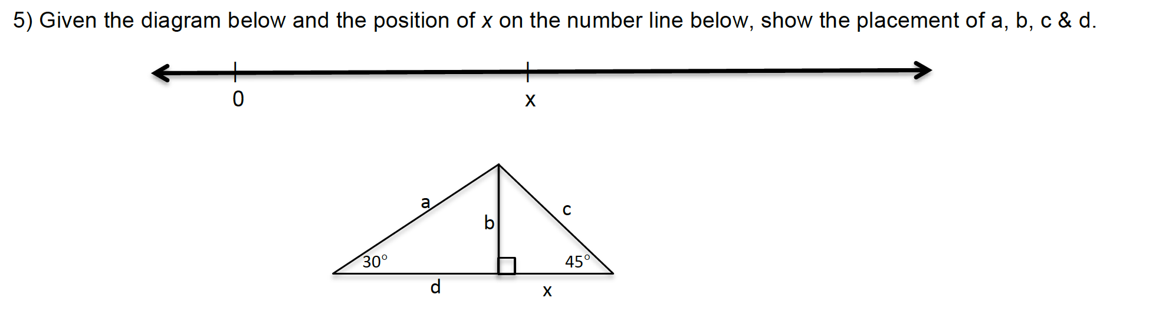
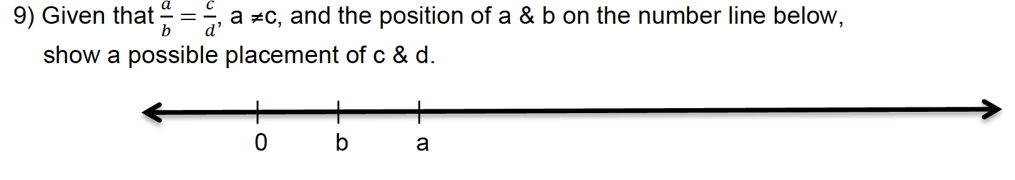
Clothesline Geometry
Assignments & Assessments
@MathProjects #clotheslinemath

Slide 10
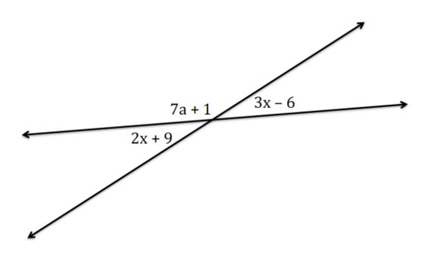
Clothesline Math
Geometry with Algebra
A.REI.1: Solve equations with variables on both sides to determine the measure of vertical angles.
3x – 6 = 2x + 9
-2x = -2x
x – 6 = 9
+ 6 = +6
x = 15
2x + 9, 3x – 6,
2x, 3x,
x
@MathProjects #clotheslinemath

Slide 11
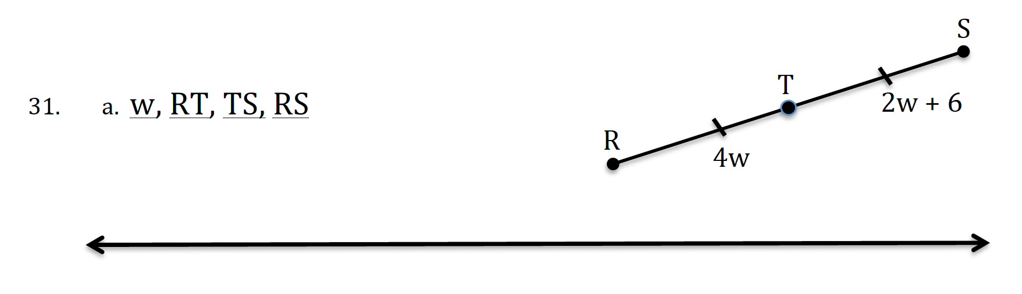
Clothesline Geometry
Assignments & Assessments
@MathProjects #clotheslinemath
Notes:
11:15
SINGLE

Slide 12

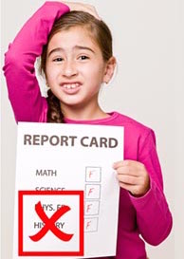

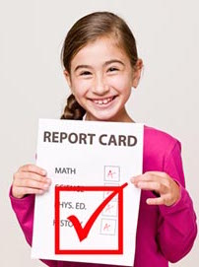
Clothesline Math
The Need for Number Sense
Build Number Sense…
…intentionally!
@MathProjects #clotheslinemath

Slide 13
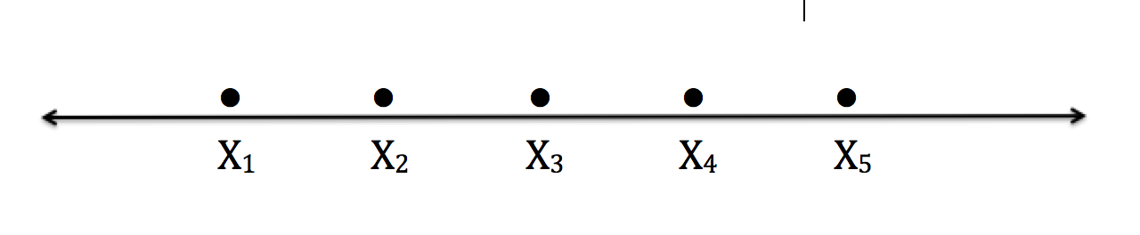
Clothesline Math
Statistics
S.ID.2: Reason abstractly to compare measures of center & spread between two data sets.
Same
Smaller
Same
Smaller
Smaller
Larger
Larger
Smaller
Smaller
Smaller
Same
Range
Standard Deviation
Average

Slide 14

Clothesline Math
Reflection
Why Clothesline Math?
Modernizing Mathematics

Slide 15
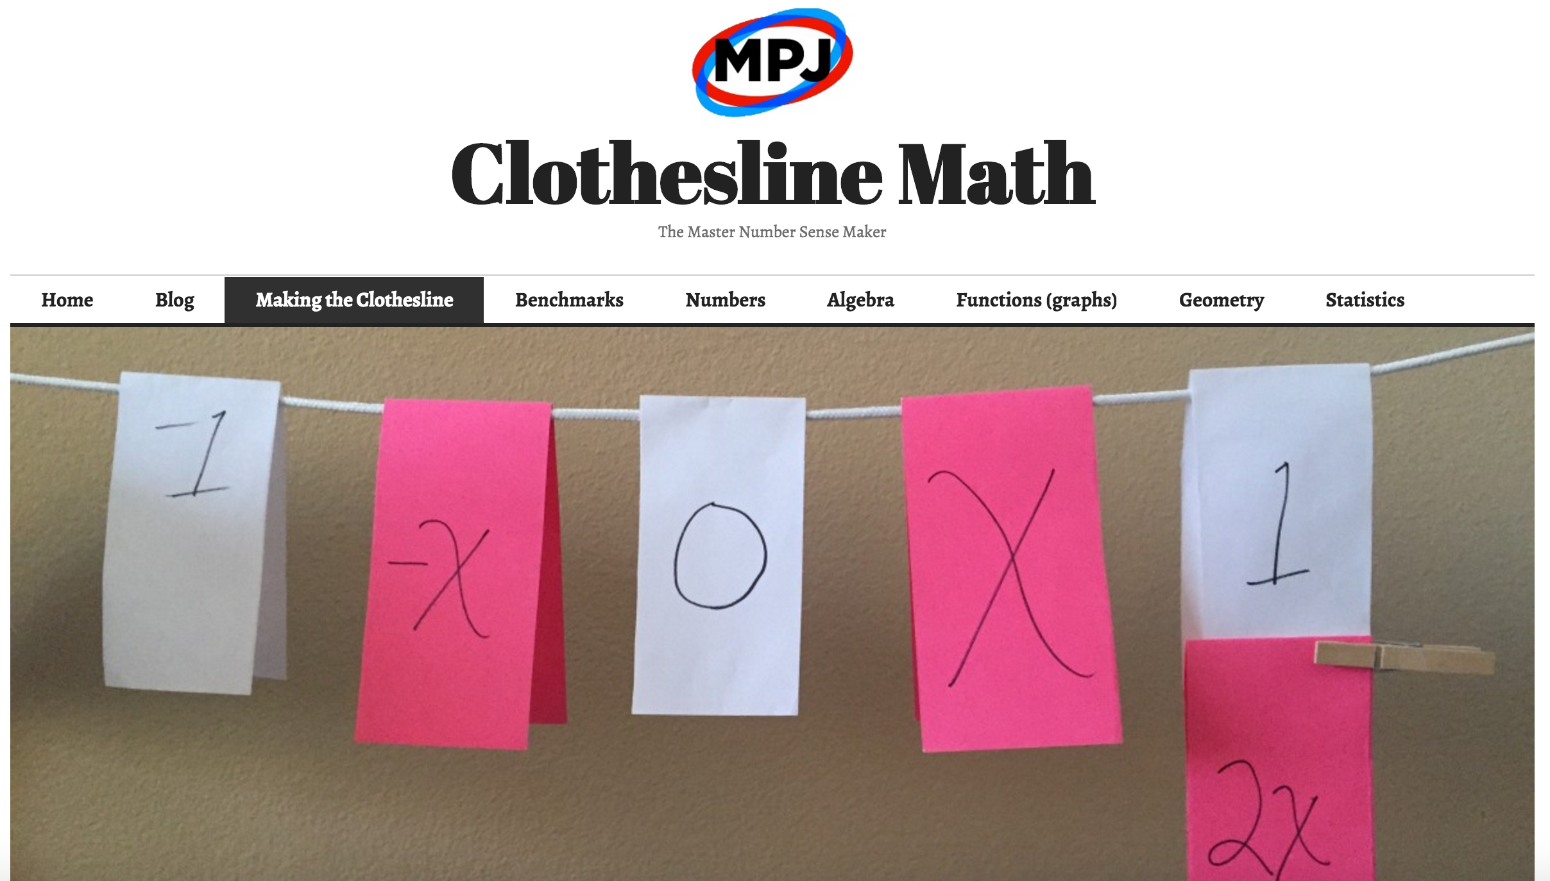
Clotheslinemath.com
Open Resource
@MathProjects #clotheslinemath

Slide 16
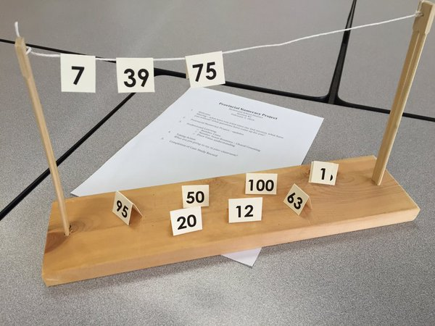
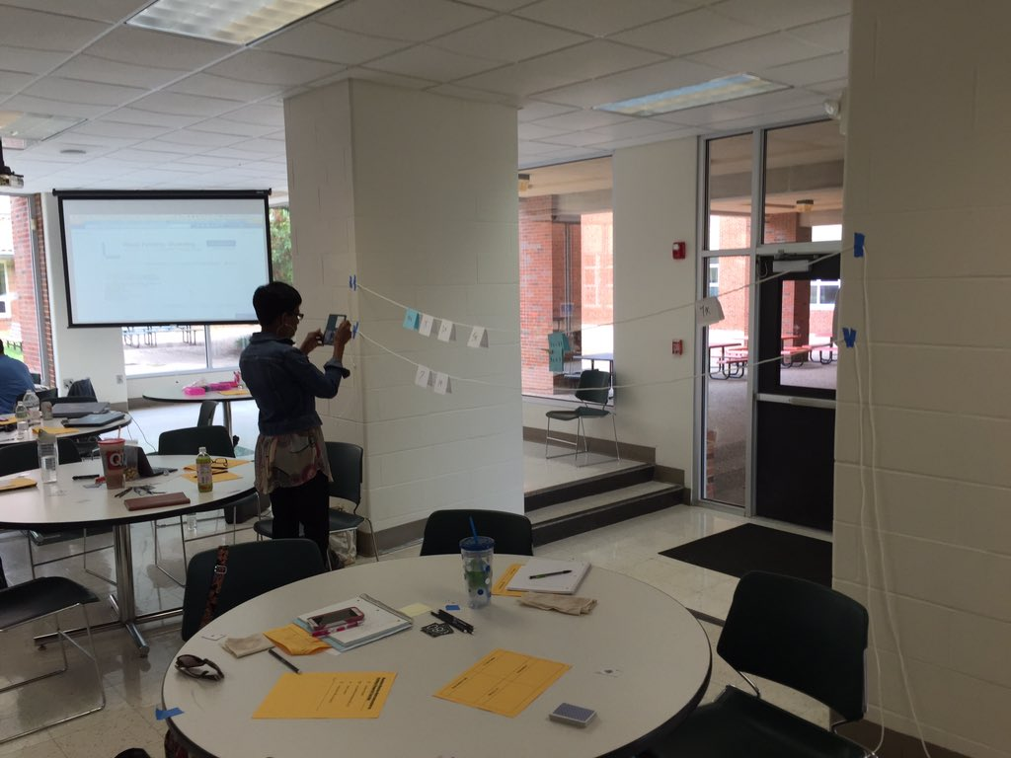
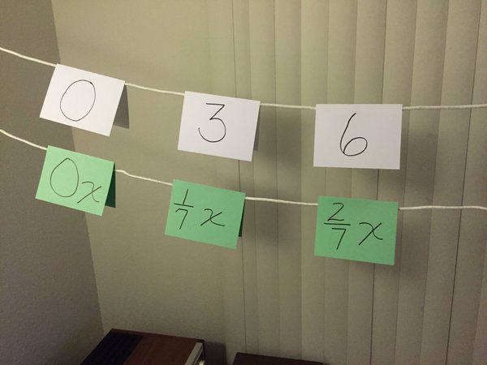
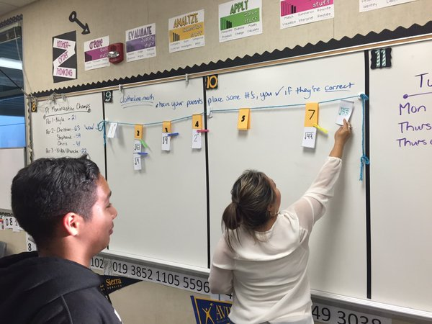
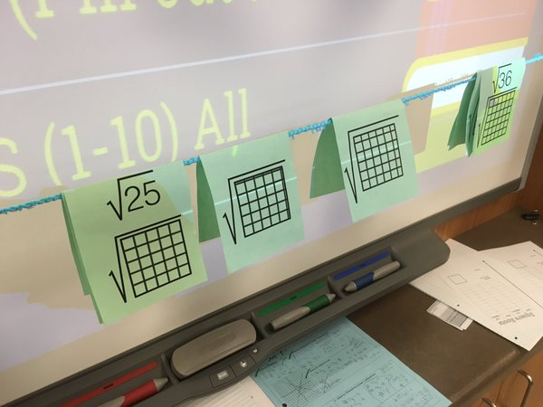
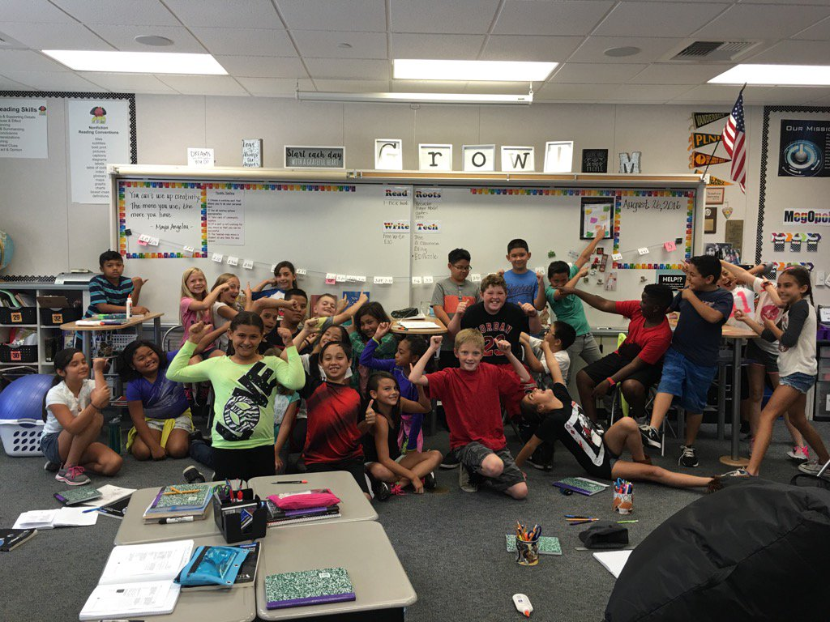
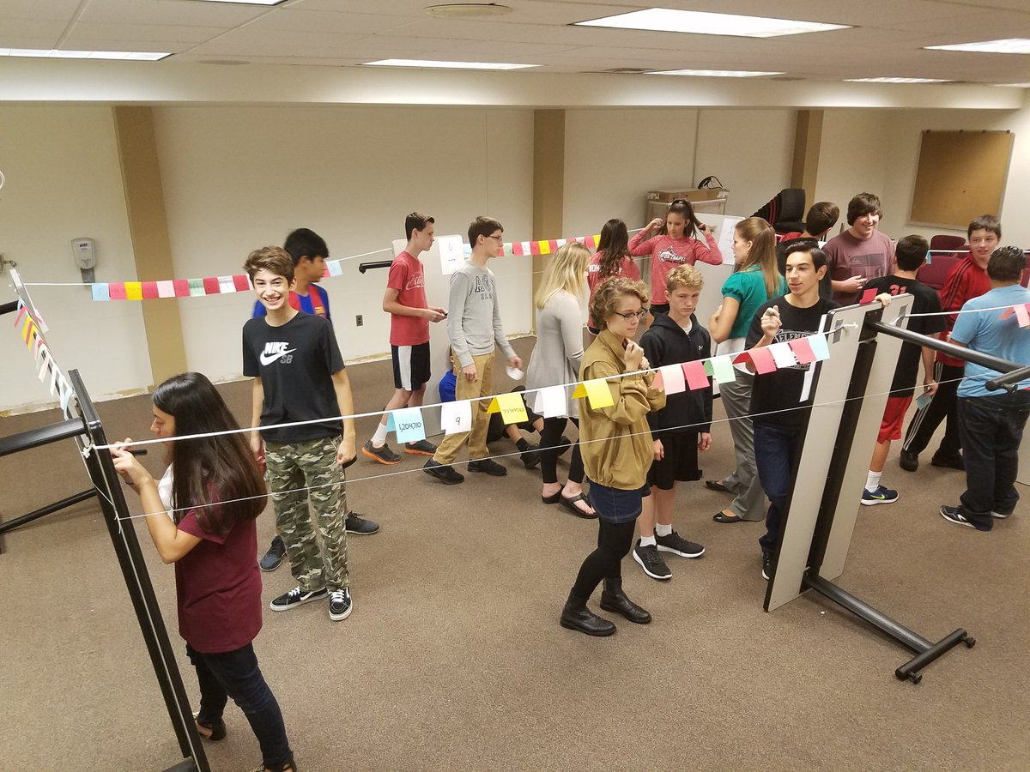
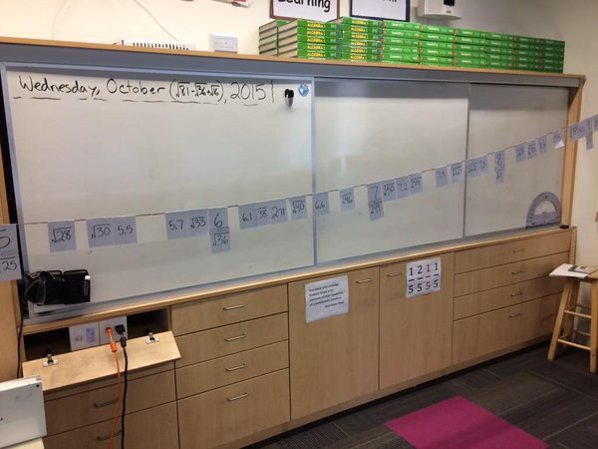
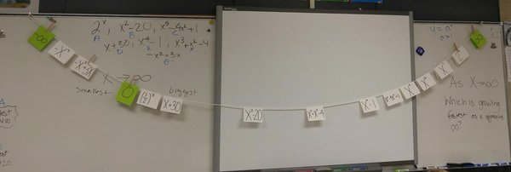
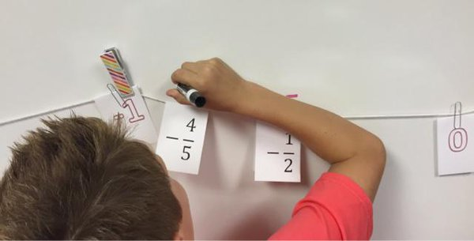
Clothesline Math
Around the World
@MathProjects #clotheslinemath

Slide 17



Clothesline Math
Call to Action
Fail Grandly
2-Week Rule
No Real Risk
10%
@MathProjects #clotheslinemath

Slide 18
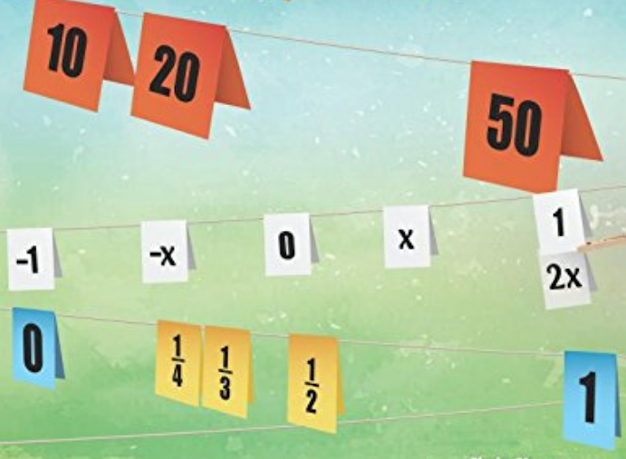
shore@mathprojects.com
clotheslinemath.com
…with the faith that they can learn it,
and that we can teach it to them,
…change the world,
one clothesline math lesson at a time.
@MathProjects #clotheslinemath

